Slide 1


Slide 2


Welcome – Vitajte
Slovakia at CERN
to Accelerating Science and Innovation
Notes:
2

Slide 3
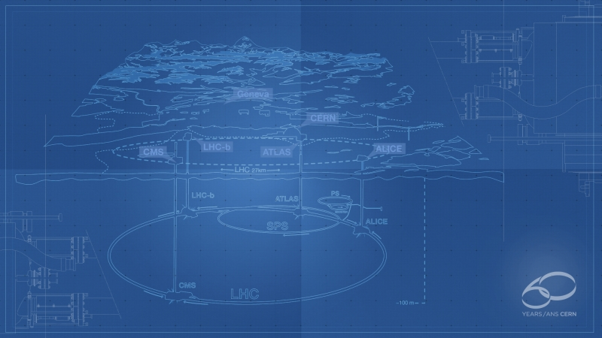

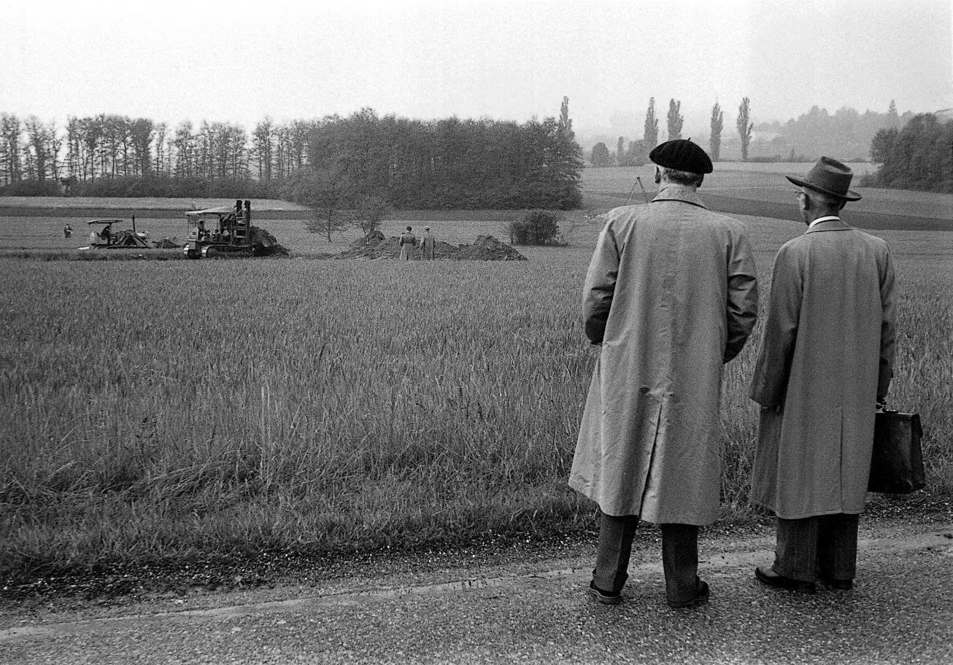

Short History of CERN
CERN Laboratory was conceived on July 1st, 1953, by and at UNESCO (itself 8 years old at that time, still they consider us as their baby)
Born after 15 month, on September 29th, 1954 (t( (we are few months after 60 birthday!)
In the mean time excavation works started on May 17th, 1954
…and I was born

Slide 4
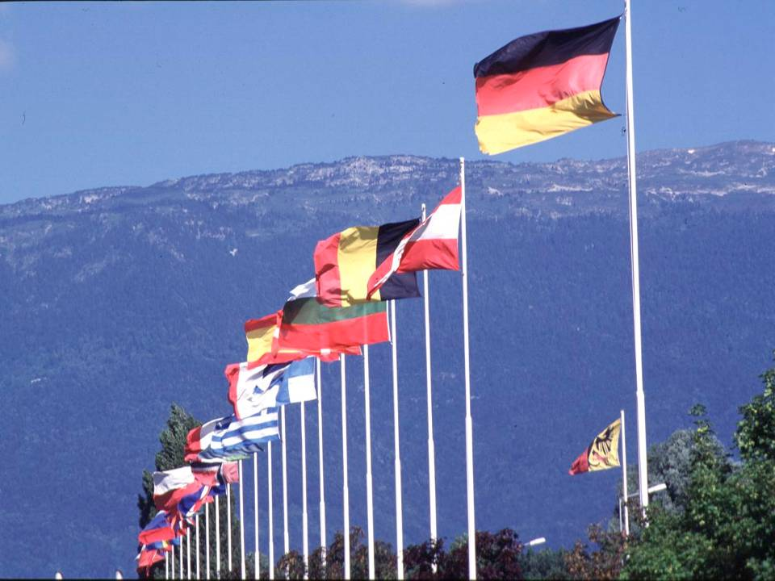

CERN was founded 1954: 12 European States
“Science for Peace”
Today: 21 Member States
~ 2300 staff
~ 1600 other paid personnel
~ 10500 scientific users
Budget (2014) ~1000 MCHF
Member States: Austria, Belgium, Bulgaria, the Czech Republic, Denmark, Finland, France, Germany, Greece, Hungary, Israel, Italy, the Netherlands, Norway, Poland, Portugal, Slovakia, Spain, Sweden, Switzerland and
the United Kingdom
Candidate for Accession: Romania
Associate Member in Pre-Stage to Membership: Serbia
Applicant States for Membership or Associate Membership:
Brazil, Croatia, Cyprus, Pakistan, Russia, Slovenia, Turkey, Ukraine
Observers to Council: India, Japan, Russia, Turkey, United States of America; European Commission and UNESCO
4
Notes:
4
----- Meeting Notes (09/01/2013 14:16) -----
nnn

Slide 5
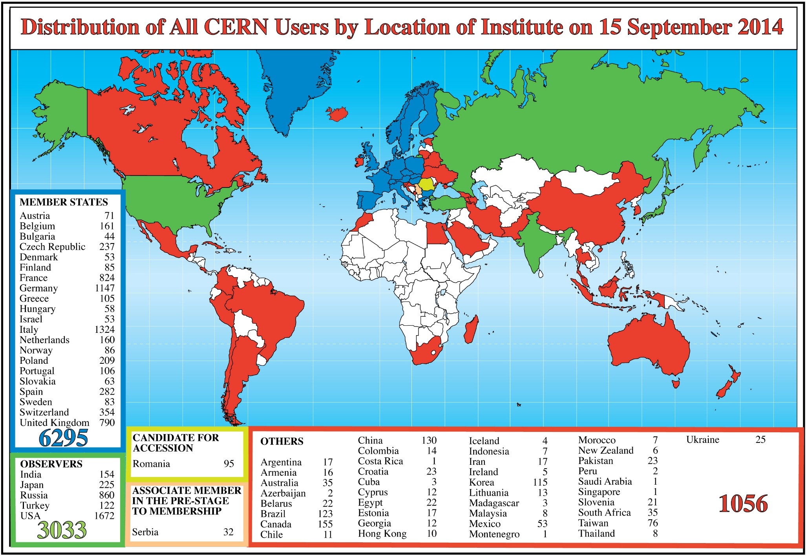
Science is getting more and more global
CERN: 16 staff, 4 fellows, 1 doctoral and 2 technical students
Notes:
5
5

Slide 6
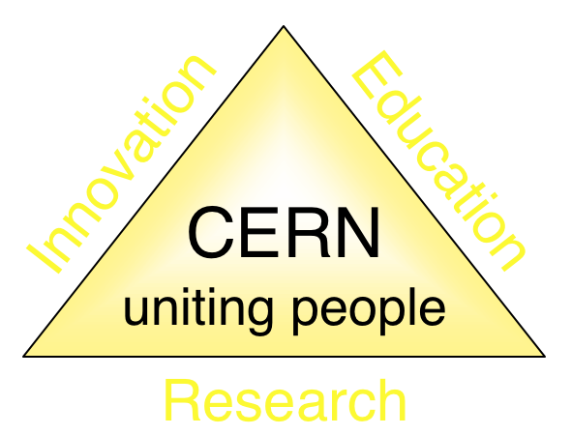
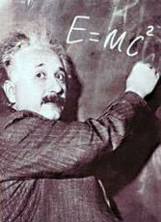
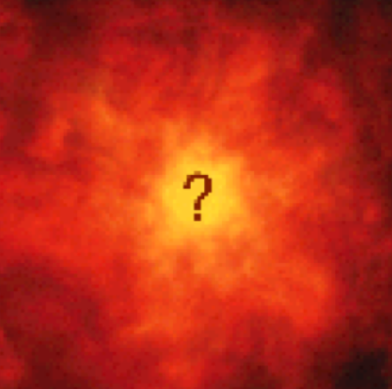


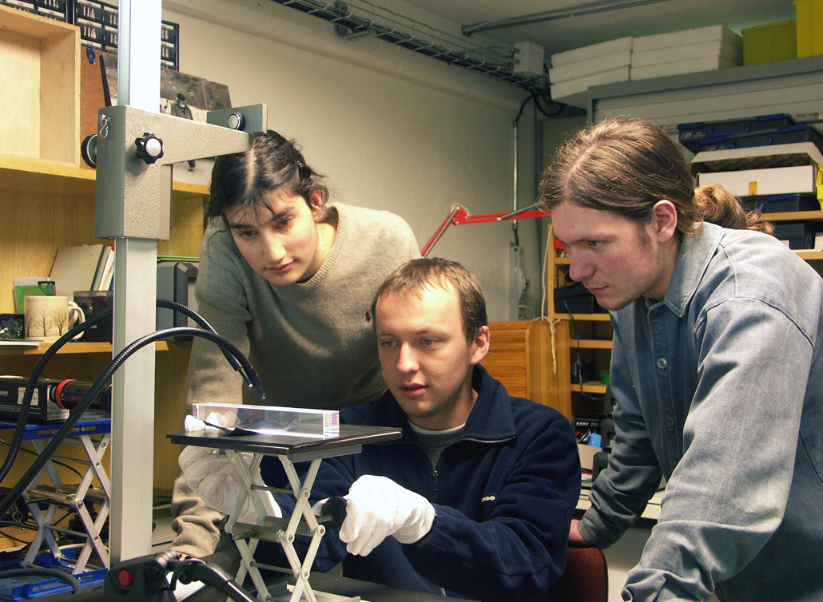
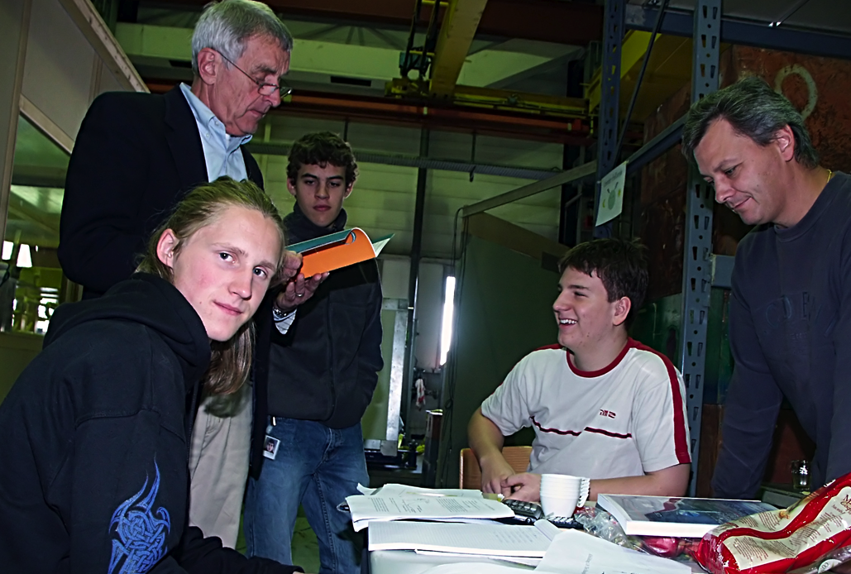
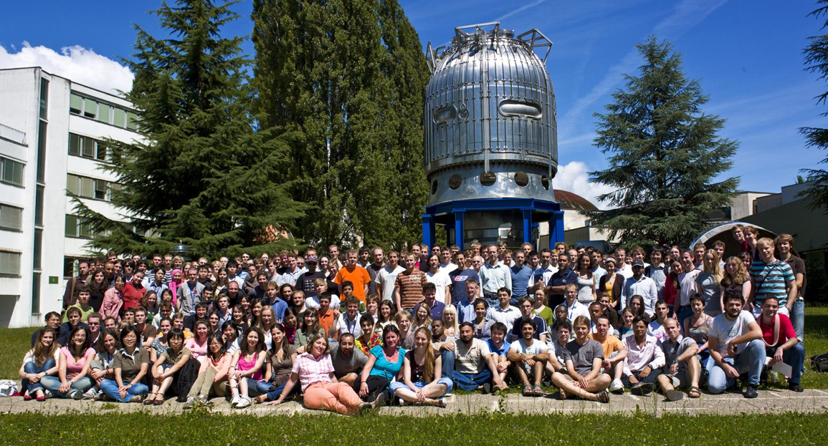
Mission of CERN
Push forward the frontiers of knowledge
The secrets of the Big Bang …what was the matter like within the first moments of the Universe’s existence?
Develop new technologies for accelerators and detectors
Information technology - the Web and the GRID
Medicine - diagnosis and therapy
Train scientists and engineers of tomorrow
Unite people from different countries and cultures
Notes:
6

Slide 7
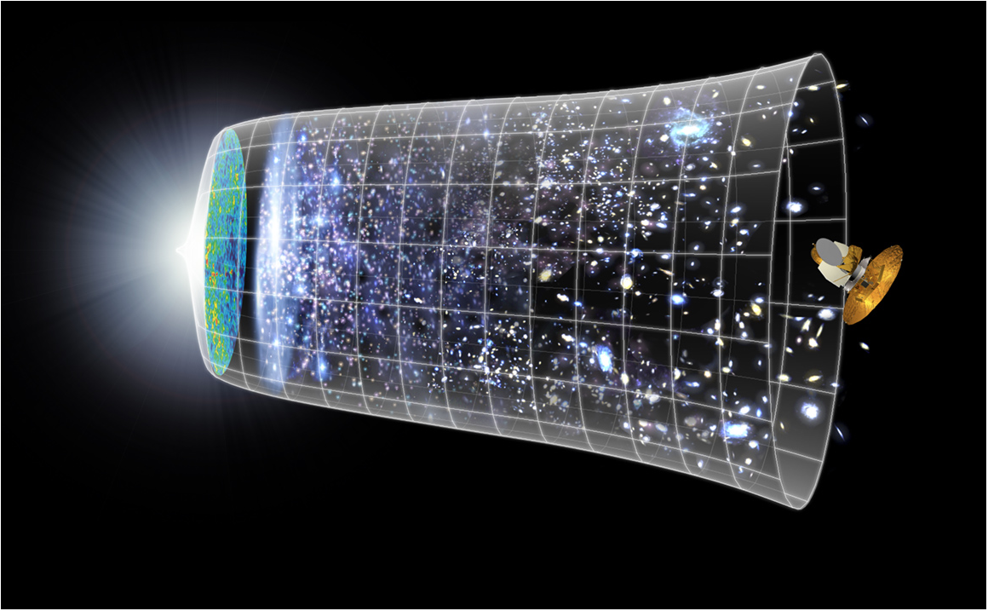
Next Scientific Challenge:
to understand the very first moments of our Universe after the Big Bang
Big Bang
WMAP
13.8 Billion Years
380,000 years
Today
10²⁸ cm

Slide 8


Veľký Tresk na Slovensku

Slide 9
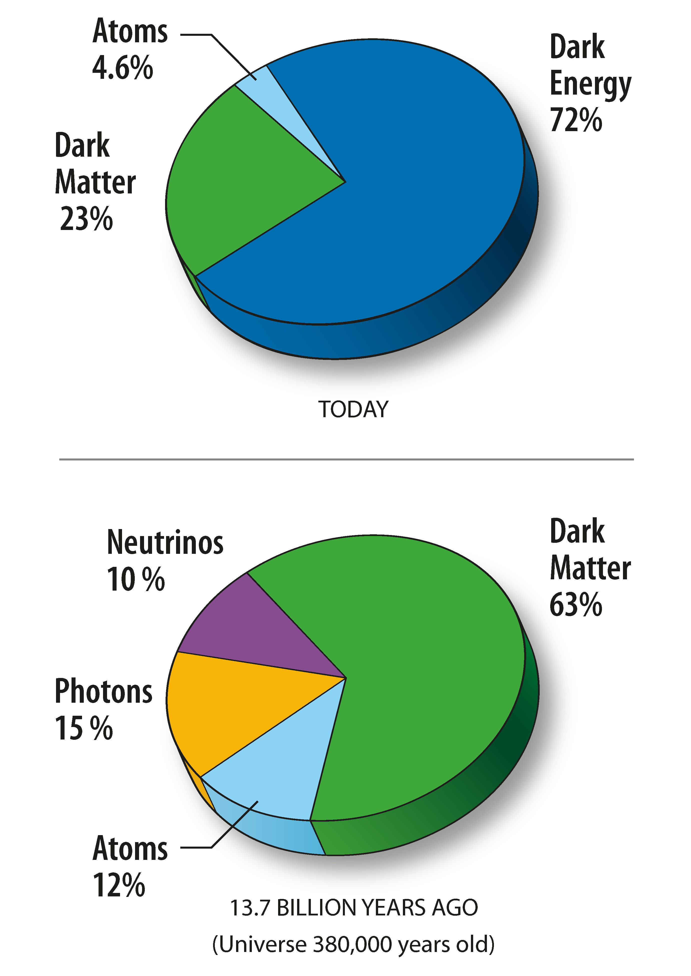
Composition of matter
today 72% of matter of the Universe – dark energy
before ~7 x 10⁹ years the Universe accelerated its expansion
23% is (cold) dark matter, what is it?
vacuum energy? scalar field? cosmological constant?

Slide 10
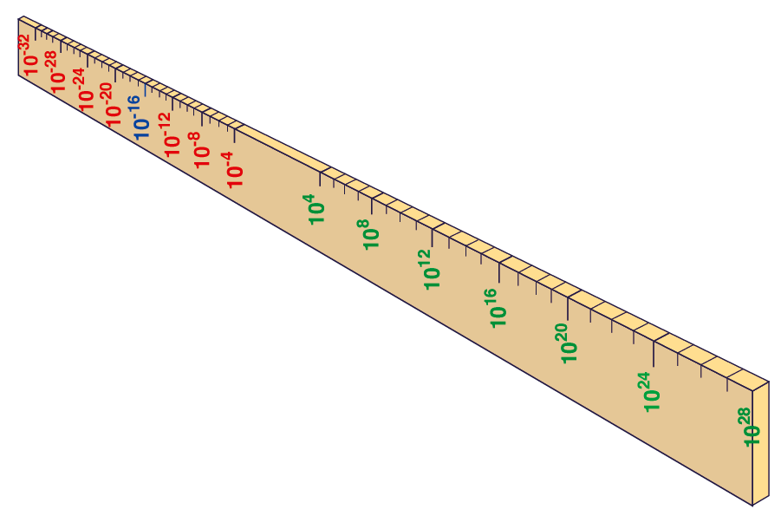
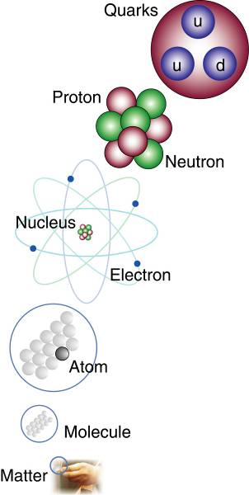
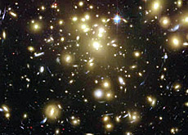

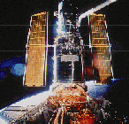
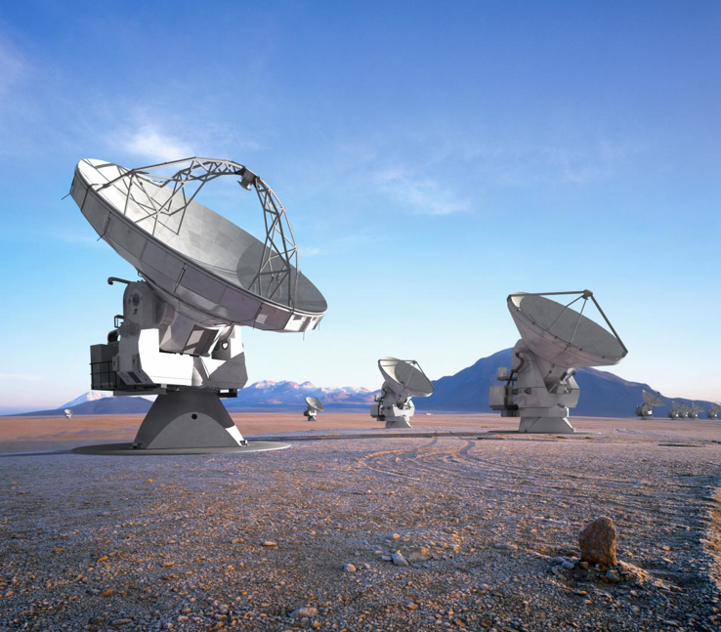
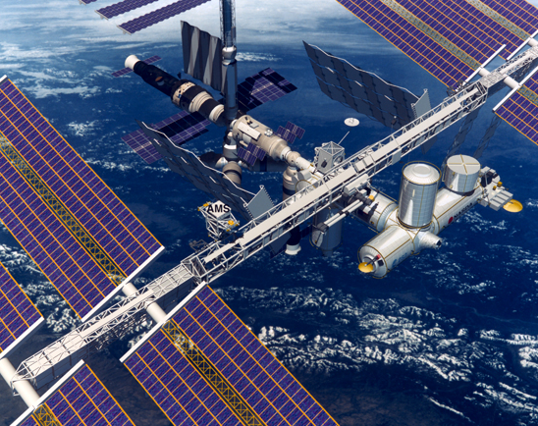
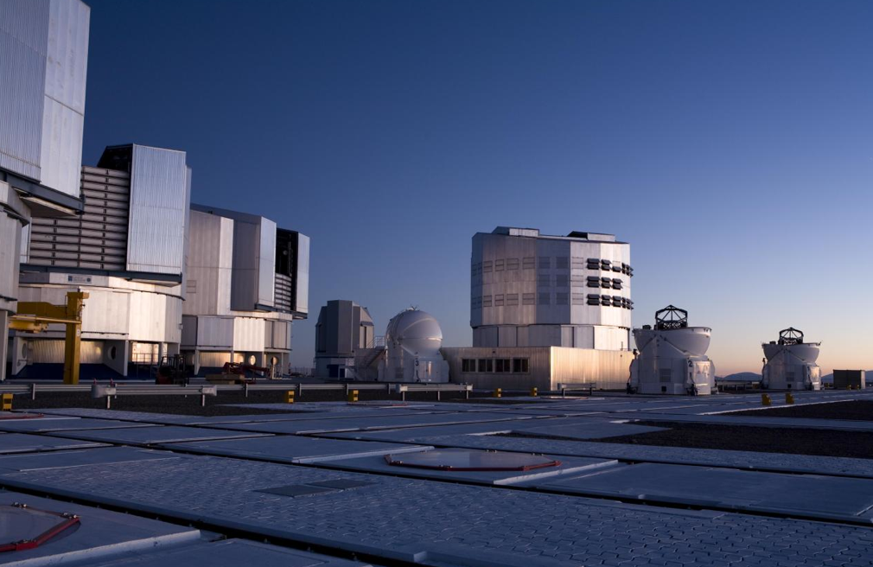
Big Bang
Proton
Atom
Radius of Earth
Earth to Sun
Radius of Galaxies
Universe
LHC
Super-Microscope
Hubble
ALMA
cm
Study physics laws of first moments after Big Bang
increasing Symbiosis between Particle Physics,
Astrophysics and Cosmology
AMS
VLT
Notes:
10
60 Grössenordnungen

Slide 11
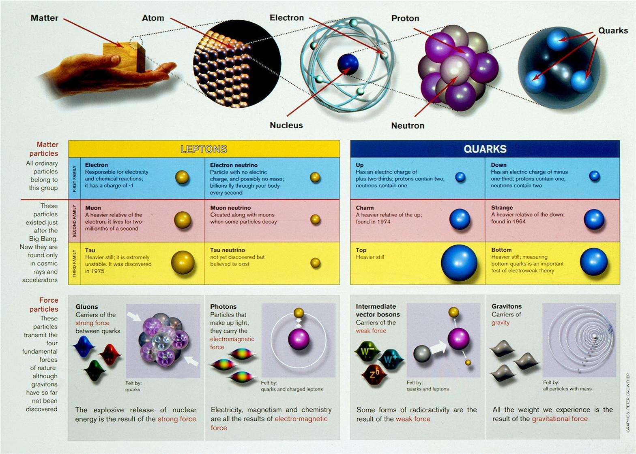
Z čoho sa skladáme ?

Slide 12
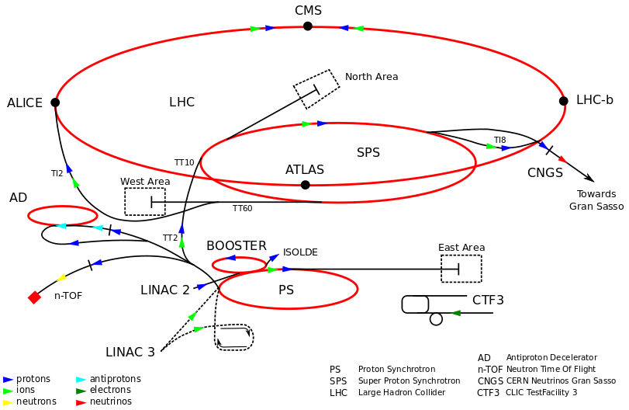
CERN Accelerators
CERN accelerator complex always reused as much as possible previously built machines in the injection chain

Slide 13
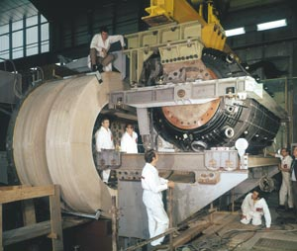
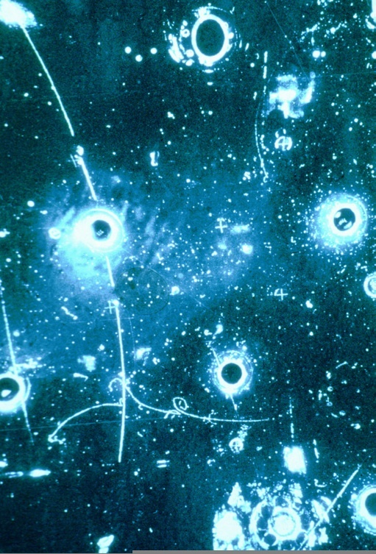
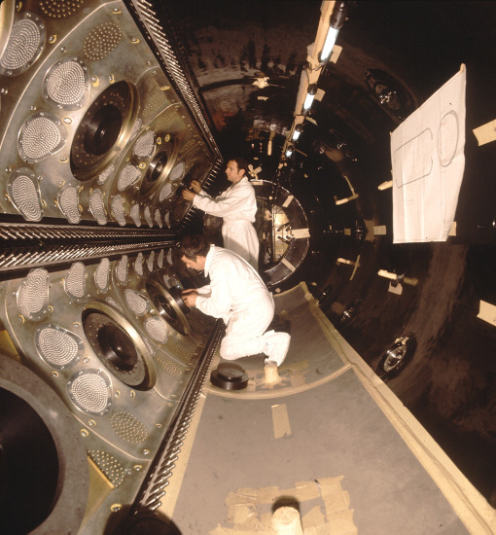
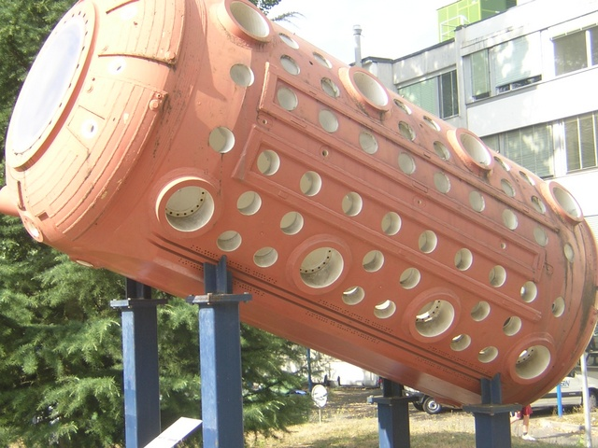
Neutral Currents
Predicted as consequence of electro-weak unification
Discovered in 1973 with Gargamelle bubble chamber exposed to ν_{μ}-beam from PS – neutrino scatters on electron without producing μ
Indication for existence of Z boson

Slide 14
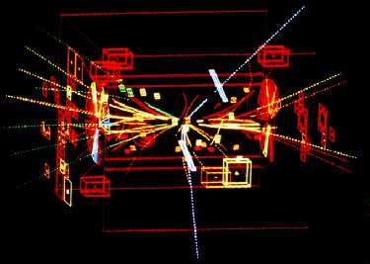
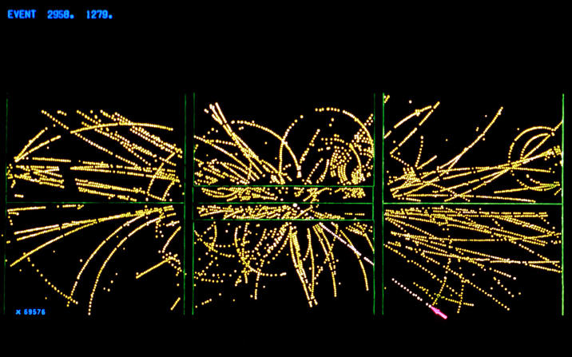
W and Z Bosons
In 1983 discovery of W and Z bosons – the carriers of electro-weak interactions was announced by UA1 and UA2 experiments
UA1 Z-boson candidate
UA2 W-boson candidate

Slide 15
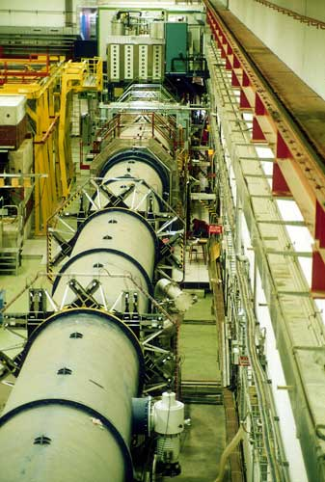
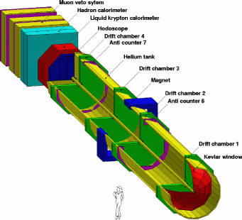
CP Violation
Discovered in neutral kaon system in 1964
In 1988 NA38 experiment at SPS evidence for direct CP violation
Confirmed in 1999 by NA48 and KTeV at FermiLab
Key to understand the asymmetry between matter and antimatter in early Universe

Slide 16
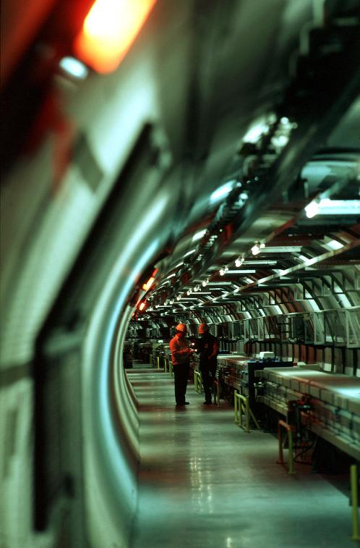
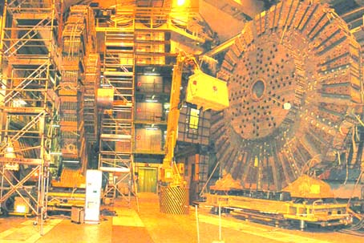
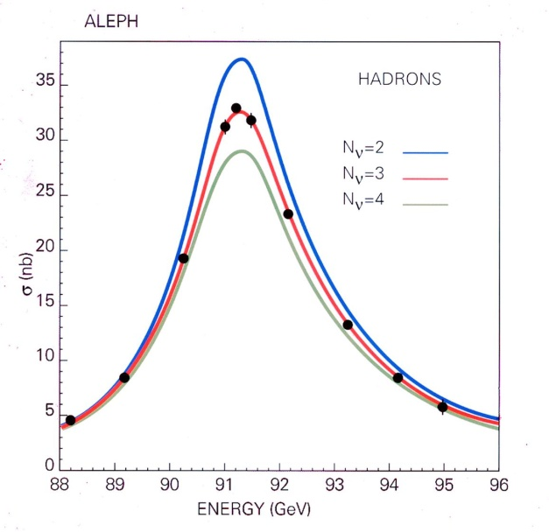
LEP
Large Electron–Positron collider project approved in May 1981
Built in 27 km tunnel between 1983 and 1988, commissioned in 1989
Operated around 90 GeV, in second phase since 1995 topped at 209 GeV
Closed down in 2000 to make way for LHC DELPHI
three generations

Slide 17
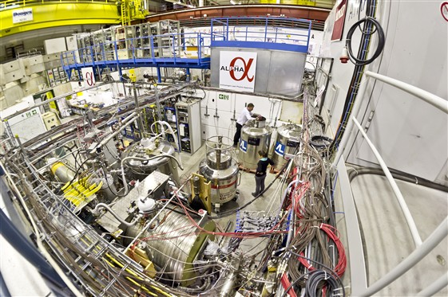
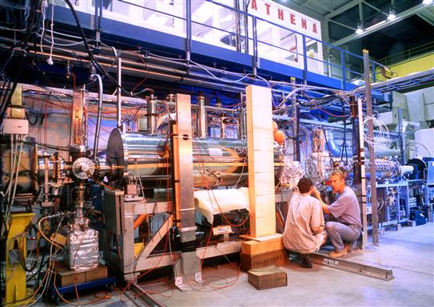
Antimatter
In 1995 the first atoms of antihydrogen produced at LEAR in PS210
ATHENA and ATRAP reported many antihydrogens in 2002
In 2011 experiment ALPHA at AD captured antiatoms for more than 15’

Slide 18
LHC
Large Hadron Collider project – multiple staged approval since 1994
Built in the former LEP 27 km tunnel between 2003 and 2008
In the same period four main experiments installed
  ALICE – specialized for heavy-ion collisions
  ATLAS – general purpose pp experiment
  CMS – general purpose pp experiment
  LHCb – specialized experiment for beauty physics
First proton beam circulated in LHC on September 10th 2008
An incident due to faulty electrical connection interrupted commissioning
Restarted one year later, first collisions on November 23rd 2009 at 0.9 TeV, till the end of that year increased to 2.3 TeV – new world record
In 2010 pp collisions at 7 TeV, in the fall first PbPb collisions at 2.76 TeV/n
In 2011 increase in luminosity, first high-lumunisity PbPb run
Energy increase to 8 TeV in 2012, first pPb collisions, continued in 2013
Till beginning of 2015 the first long shutdown to prepare further energy increase up to 13–14 TeV

Slide 19
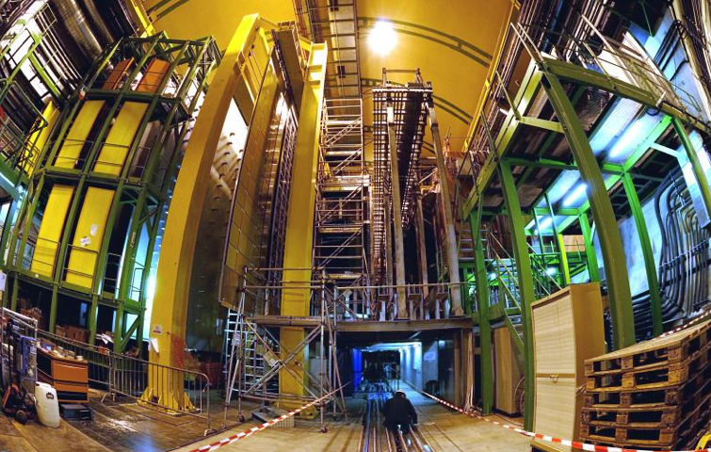


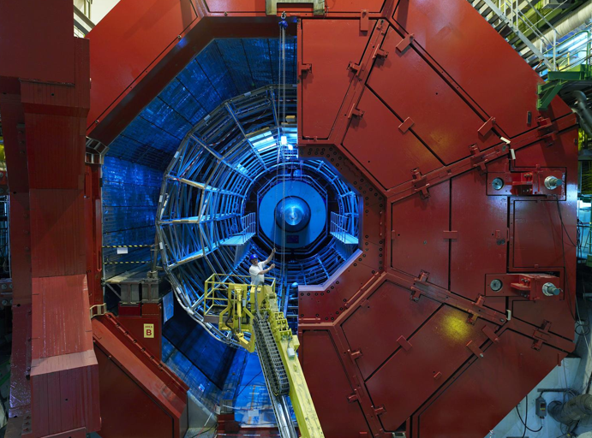

2010: a New Era in Fundamental Science
LHCb
CMS
ATLAS
Exploration of a new energy frontier
in p-p and Pb-Pb collisions
ALICE
LHC ring:
27 km circumference
Notes:
19

Slide 20
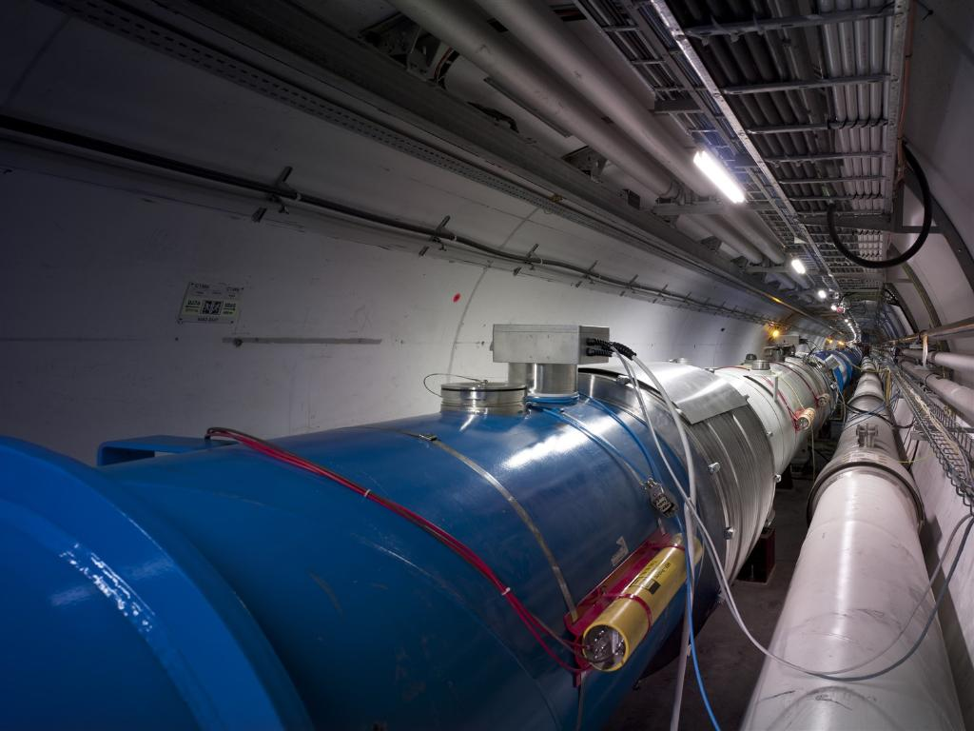
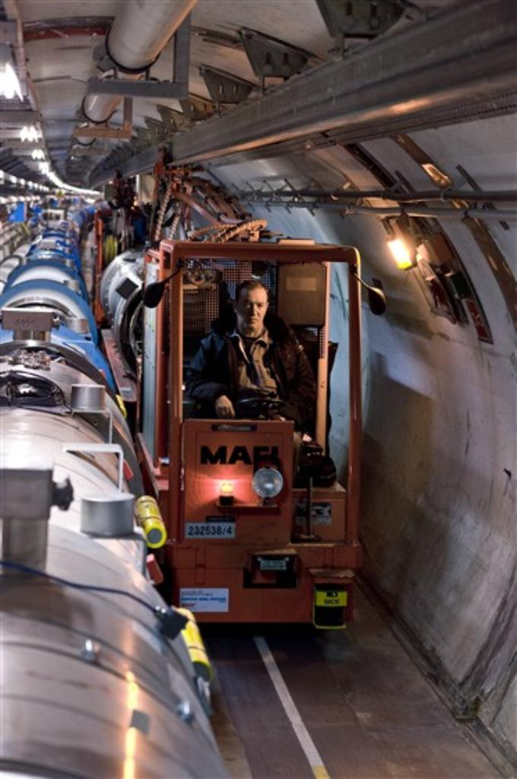
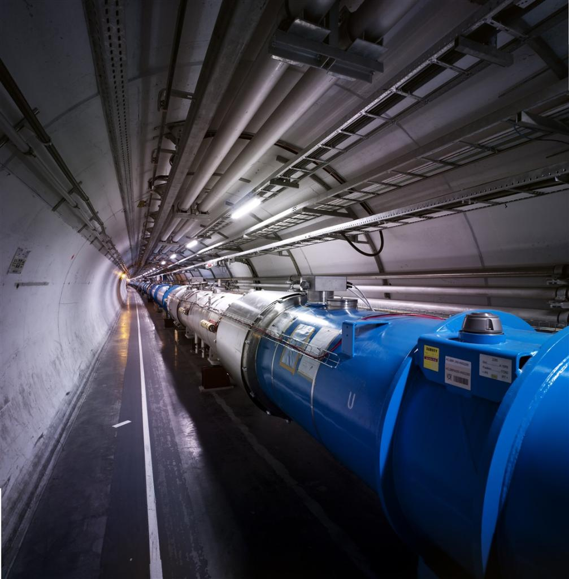
LHC

Slide 21
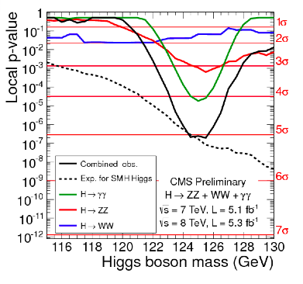
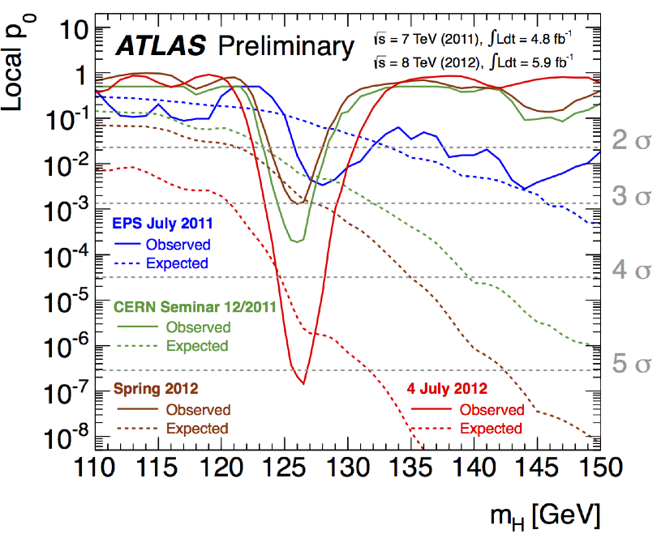
Higgs Boson
Both ATLAS and CMS reported in July 2012 observation of a new particle with the mass about 126 GeV
Further studies showed that spin-parity of this particle is compatible with expectations for predicted Higgs boson

Slide 22
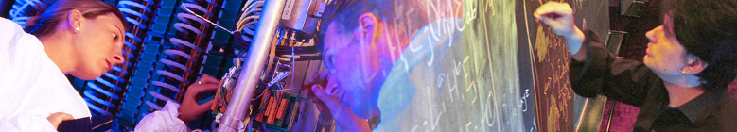

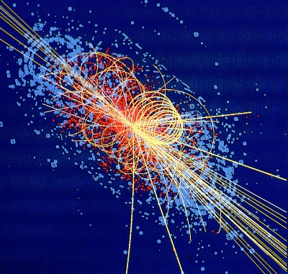
CERN: Particle Physics and Innovation
Interfacing between fundamental science and key technological developments
CERN Technologies and Innovation
Accelerating particle beams
Detecting particles
Large-scale computing (Grid)
Notes:
22

Slide 23
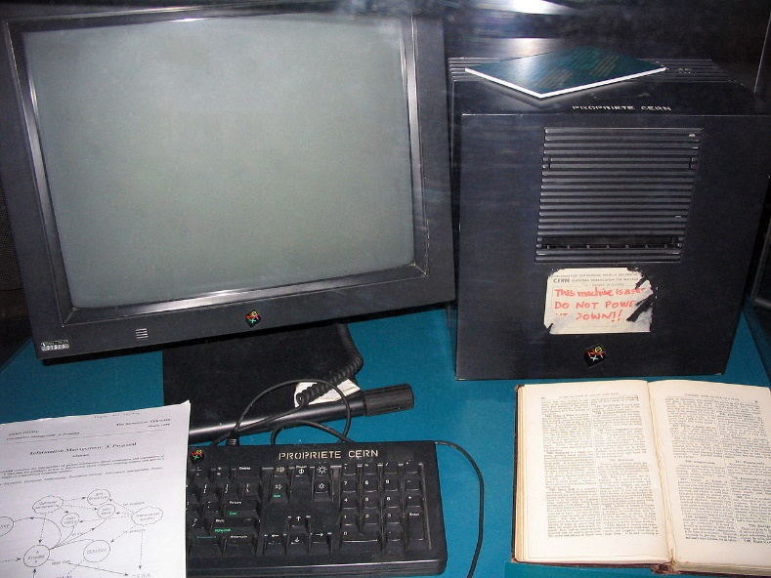
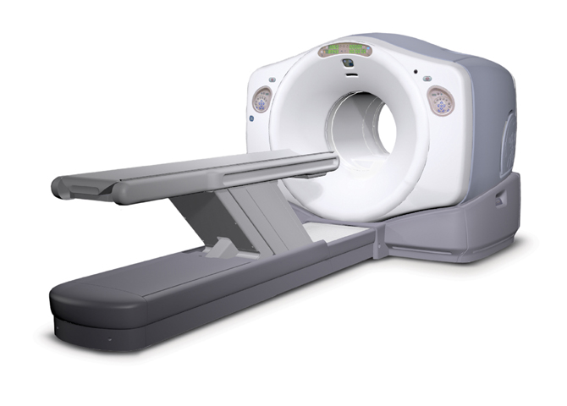
New Technologies
Many examples of technological developments successfully transferred to society
Medical applications: PET scanners, hadron therapy, diagnostic detection
Computing technologies: World Wide Web, GRID

Slide 24
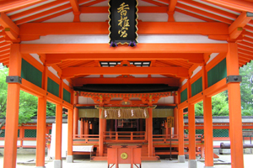
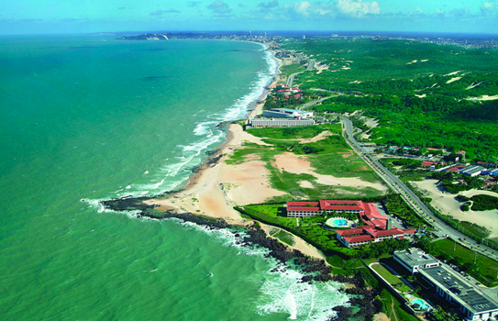
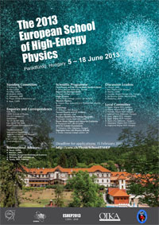
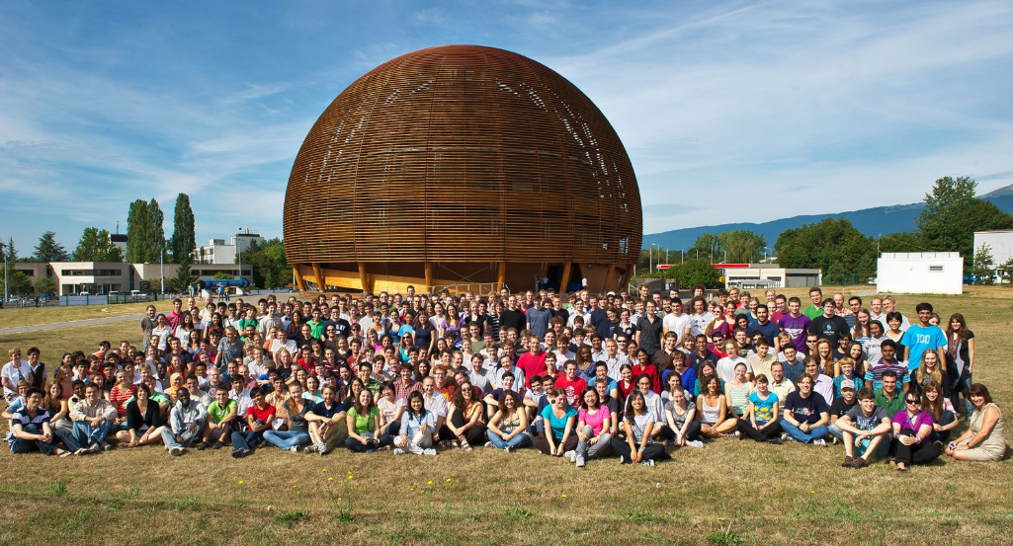
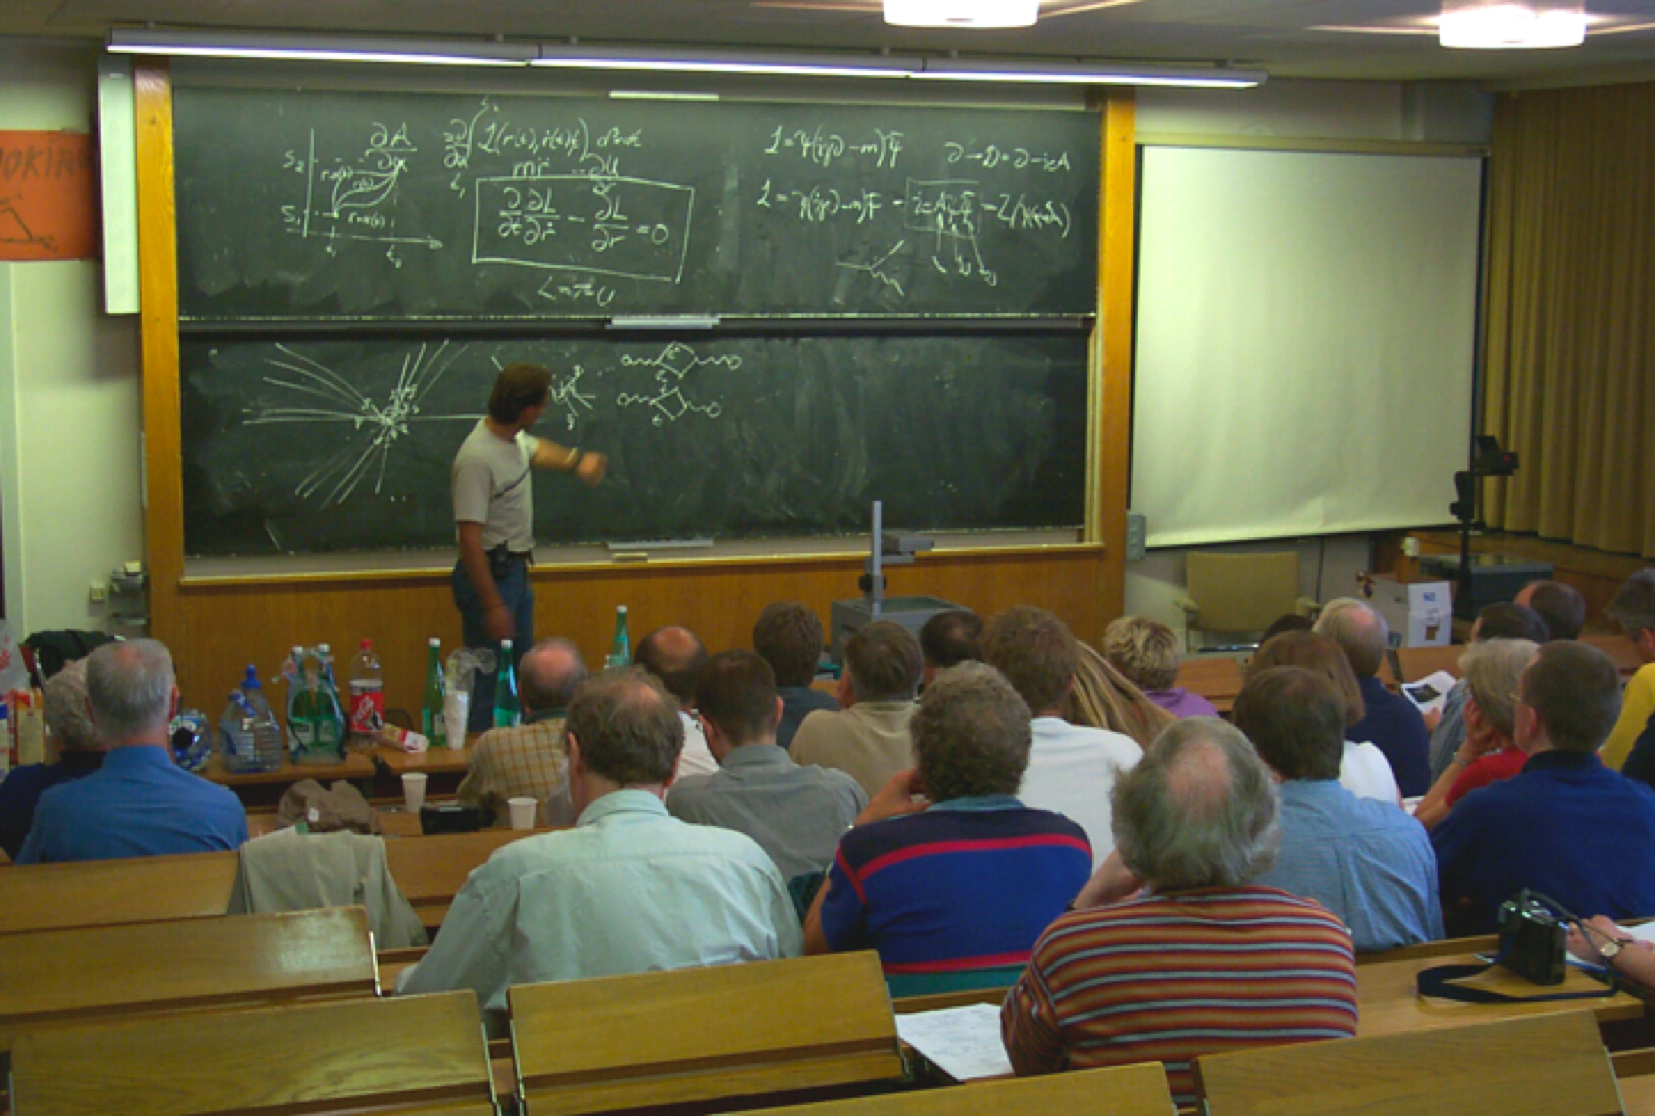
CERN Education Activities
Latin American School
Natal, Brazil, 2011
Arequipa, Peru, 2013
NEW:
Asia-Europe-Pacific School of High-Energy Physics
Fukuoka, Oct 2012
India, 2014
Scientists at CERN
Academic Training Programme
Young Researchers
CERN School of High Energy Physics
CERN School of Computing
CERN Accelerator School
CERN School of Physics
Hungary, June 2013
Physics Students
Summer Students
Programme
CERN Teacher Schools
International and National Programmes

Slide 25

CERN Teacher Programme

Slide 26


Summer Students 2014

Slide 27


Slovakia and CERN
Slovakia became CERN Member State in 1993
Today research in particle physics is carried out mainly at 4 Institutes:
  Comenius University Bratislava
  Institute of Experimental Physics of the Slovak Academy of Sciences, Košice
  Institute of Physics of the Slovak Academy of Science, Bratislava
  Šafárik University Košice
Concentrated effort to participate in the LHC experiments ALICE and ATLAS:
Total 31 members from
Comenius University and
  Institute of Experimental Physics of the Slovak Academy of Sciences, Košice
Notes:
27

Slide 28






Slovakia and CERN
Contributions to ALICE
16 members
Contributions to ATLAS
15 members
Tile calorimeter in test beam
Tile calorimeter:
Bratislava
Iron tiles produced in Dubnica
TPC: Bratislava
Production and test of 26 readout chambers at Bratislava Detector Laboratory
Pixel detector:
Košice
Electronics for readout
Electronics cards for LAr endcap calorimeter: Košice
Lifting devices for calorimeter modules produced in Prešov
Notes:
28

Slide 29


Slovakia and CERN
Contributions to LHC project from Industry in Slovakia
Blue cryostat for LHC dipoles produced at SES (Slovenské energetické strojárne, Tlmače)
Robots carry LHC magnets and align them with magnet support jacks made by ZŤS (Závody ťažkého strojárenstva, Košice)
LHC award to ZTS
Notes:
29

Slide 30

CERN
– an example (probably unique) of international collaboration acting independently of political views and religions
– bringing people together, always well ahead of political decisions

