Slide 1
Introduction to Grid Computing May 2013 Marian Babik CERN
The LHC Computing Grid Marian Babik (orig. by Rafal Otto, GridCafe), CERN

Slide 2
Outline
Networking
Web
Web 2.0
Distributed systems
Grid
Cloud

Slide 3
Networking

Slide 4
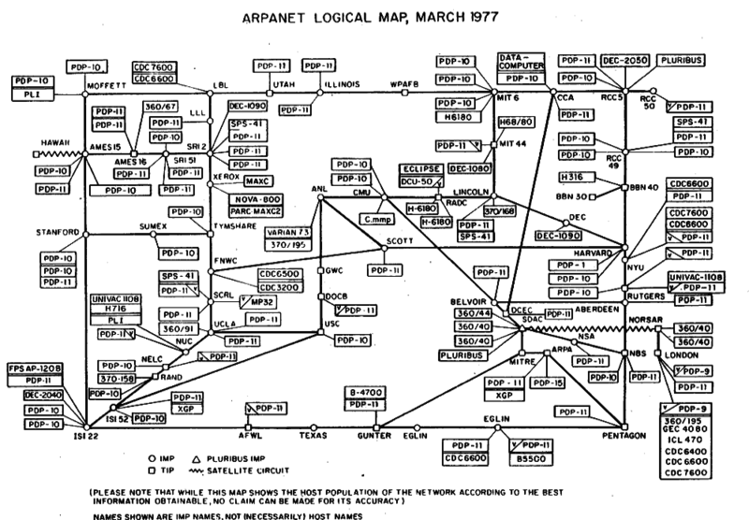
Networking
Notes:
Advanced Research Projects Agency Network (ARPANET)
world's first operational packet switching network / prepinanie paketov, - digital networking communications method that groups all transmitted dat
the first network to implement TCP/IP, and the progenitor of what was to become the global Internet.

Slide 5
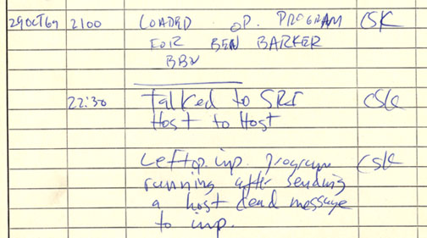
Networking
ARPAnet (Advanced Research Projects Agency Network, 1962)
MIT, DARPA, US Dept. of Defense,
first operational packet switching network
data system could use one communications link to communicate with more than one machine by disassembling data into datagrams, then gather these as packets.

Slide 6
Networking
+ many others (UUCP, NPL, X.25, etc.)
TCP/IP network stack
IP(Internet protocol) – datagrams, packets, addressing
IP Address
32bit (4 bytes) (e.g. 209.85.229.147)
4,294,967,296 (2^32)
Domain Name System (DNS)
www.google.com -> 209.85.229.14
TCP (Transmission Control Protocol)
provides the service of exchanging data reliably directly between two network hosts
Notes:
From 1973 to 1974, Cerf's networking research group at Stanford worked out details of the idea, resulting in the first TCP specification
Between 1984 and 1988 CERN began installation and operation of TCP/IP to interconnect its major internal computer systems, workstations, PCs and an accelerator control system
RIRs APNIC on 15 April 2011 and RIPE NCC on 14 September 2012

Slide 7
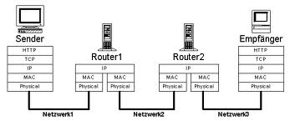
Networking
Routing
how to deliver packets from one host to another
Graph theory
Minimum spanning tree
Shortest path
Throughput/Latency
average rate of successful message delivery over a communication channel
10Mbit/100Mbit/1Gbit
measure of time delay experienced in a system
Notes:
1 megabit = 10^6 bits = 1000000bits = 125 kB
10 Mbit = 1.25 MB/s
100 Mbit = 12.5 MB/s
1 Gbit = 125 MB/s t.j. 750 MB za 6 sekund

Slide 8
web

Slide 9
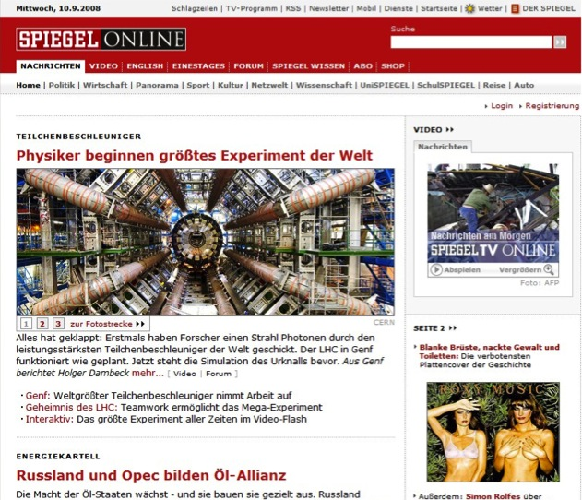
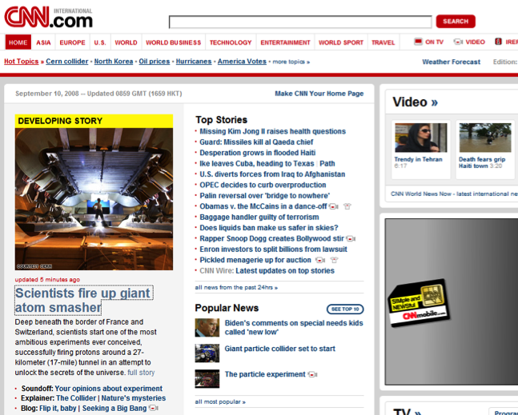
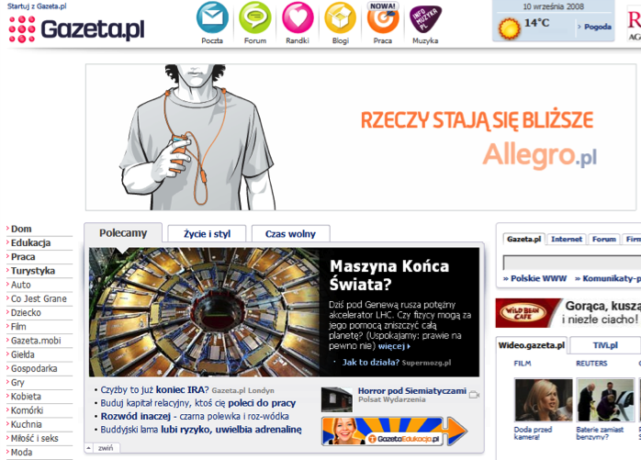
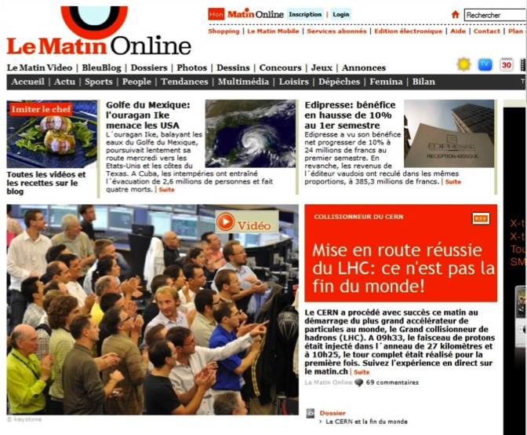
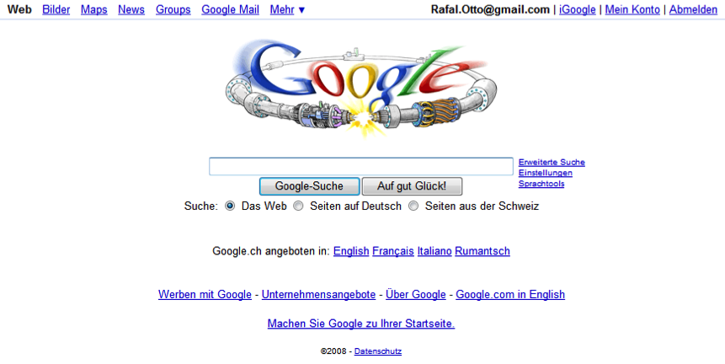
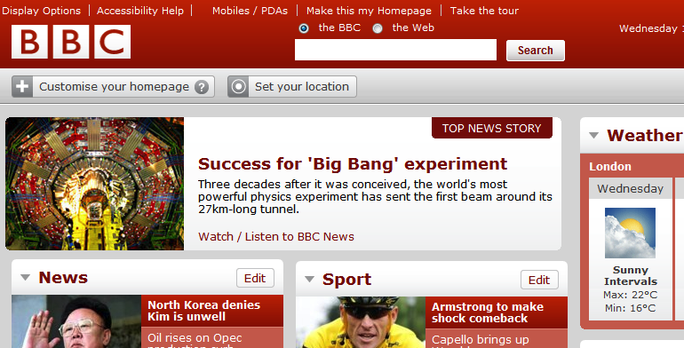
Web of Today!
The LHC Computing Grid – Marian Babik ((orig. by Rafal Otto, GridCafe), GridCafe, CERN

Slide 10
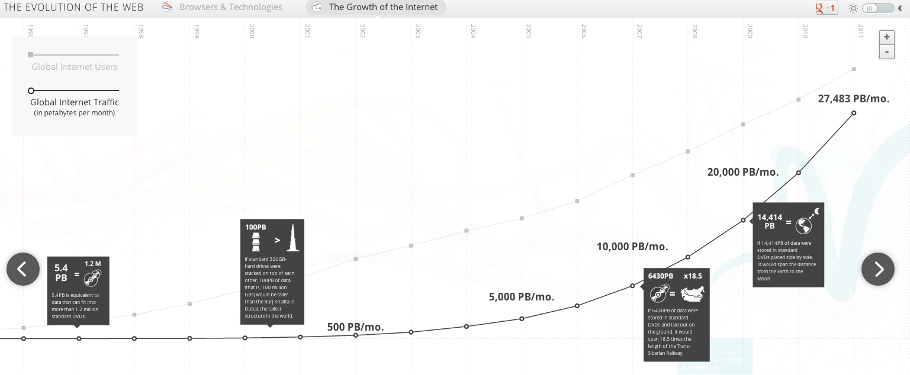
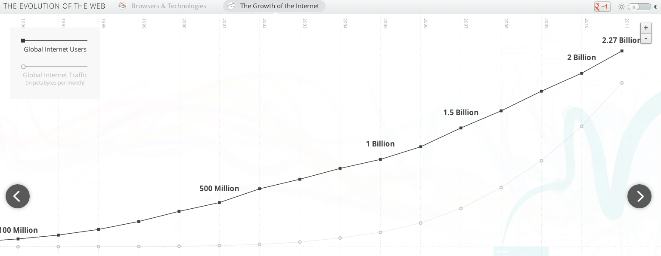
Web of Today
source: http://www.evolutionoftheweb.com/
Notes:
facebook – 1.13 billion in 2013
google+ - 500 million

Slide 11
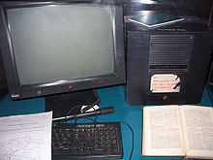
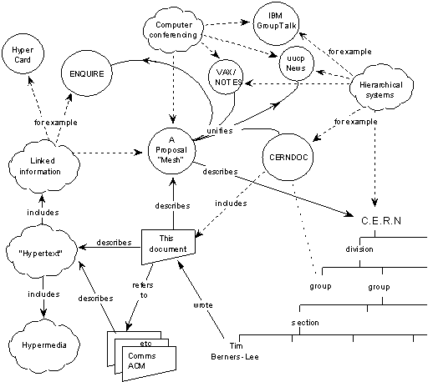
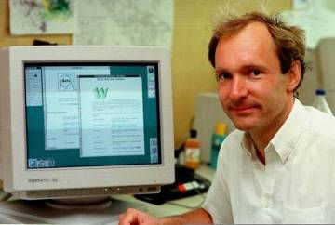
What is the Web ?
Internet + Hypertext
Hypertext ?
text displayed on a computer or other electronic device with references
1991: Early www system released to HEP via the CERN program library. First web servers located in European physics laboratories.
1993: First Mosaic browser; web reaches 500 servers and 1% of Internet traffic; CERN places WWW in the public domain.

Slide 12
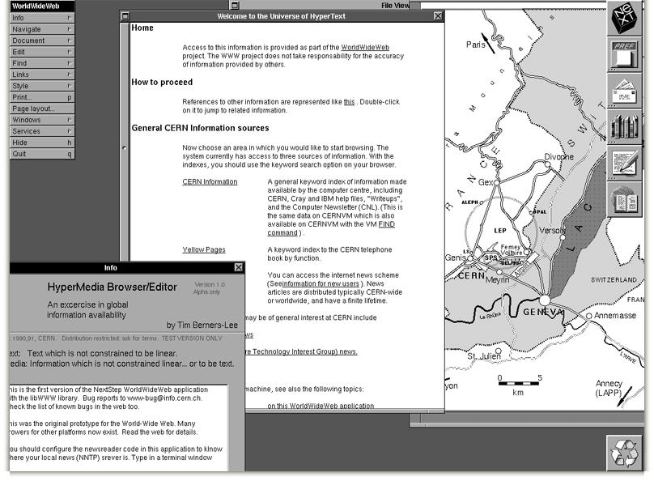
Web browser

Slide 13
What happens when you visit a web page
HTTP (HyperText Transfer Protocol) request
DNS
facebook.com -> 66.220.156.25
TCP/IP
Message -> packets -> datagrams
Routed to 66.220.156.25 port 80
HTTP

Slide 14
What happens when you visit a web page
HTTP response
DNS, TCP/IP
HTML (HyperText Markup Language)

Slide 15
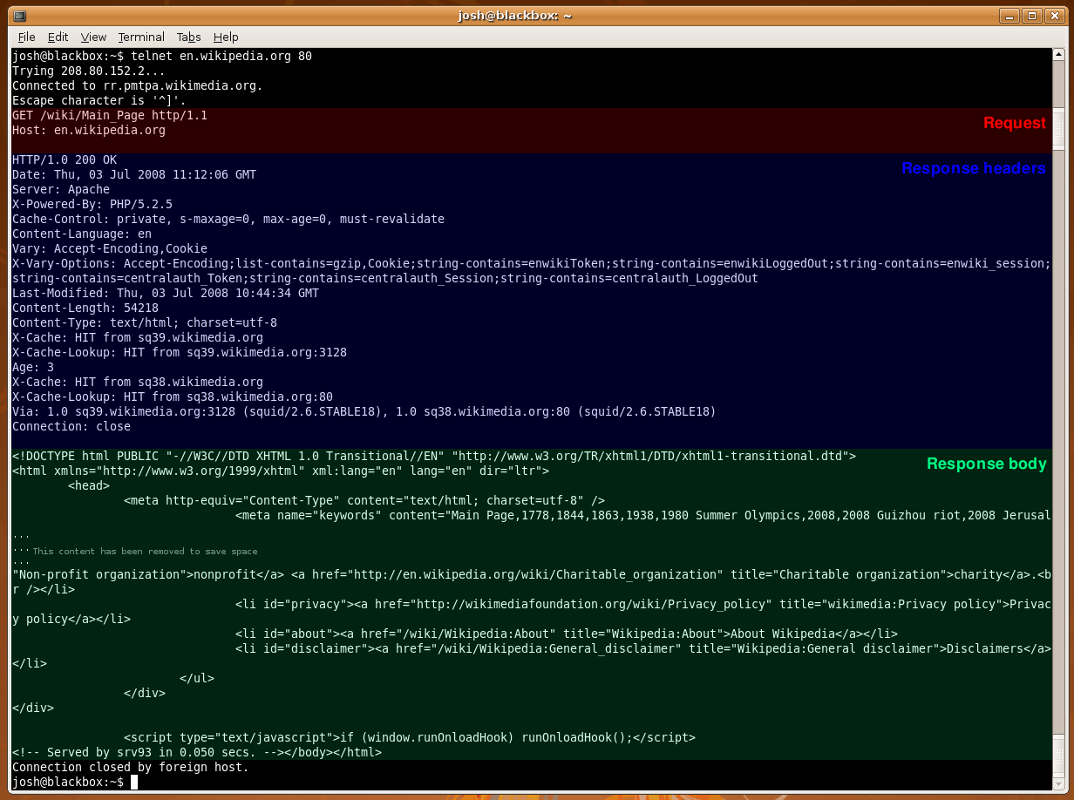
What happens when you visit a web page

Slide 16
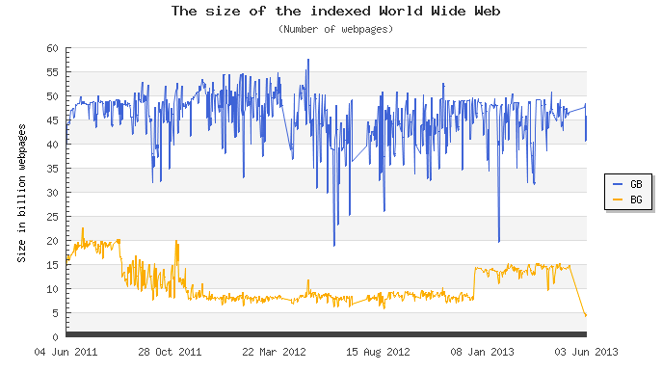
Web
Search
Pagerank – Sergey Brin, Larry Page (Google)
rank web pages that match a given search string
assumes that web pages linked from many important pages are themselves likely to be important
a recursive score for pages, based on the weighted sum of the PageRanks of the pages linking to them

Slide 17
web 2.0

Slide 18
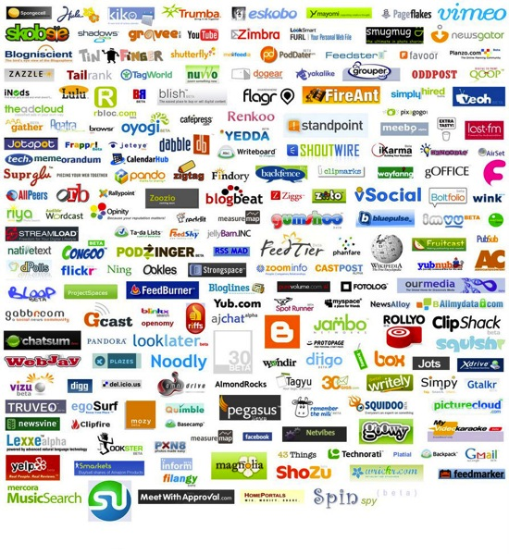
Web 2.0
The LHC Computing Grid Marian Babik (orig. by Marian Babik (orig. by Rafal Otto, GridCafe), GridCafe),, CERN

Slide 19
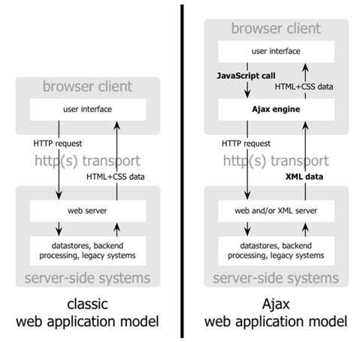
Web 2.0
Javascript
AJAX

Slide 20
Semantic Web
group of methods and technologies to allow machines to understand the meaning - or "semantics" - of information on the Web
Based on
Logic models
Information retrieval
Machine learning
e.g. Wolfram Alpha (http://www.wolframalpha.com/)

Slide 21
distributed systems

Slide 22
Distributed systems
Distributed system
Web (WIKIPEDIA)
Torrent
Distributed computing system:
Data intensive (Hadoop, map-reduce)
CPU intensive (Condor)

Slide 23
Distributed systems
Common properties
Fault tolerance
When one or some nodes fails, the whole system can still work fine except performance.
Need to check the status of each node
Each node play partial role
Each computer has only a limited, incomplete view of the system. Each computer may know only one part of the input.
Resource sharing
Each user can share the computing power and storage resource in the system with other users
Load Sharing
Dispatching several tasks to each nodes can help share loading to the whole system.
Easy to expand
We expect to use few time when adding nodes. Hope to spend no time if possible.

Slide 24
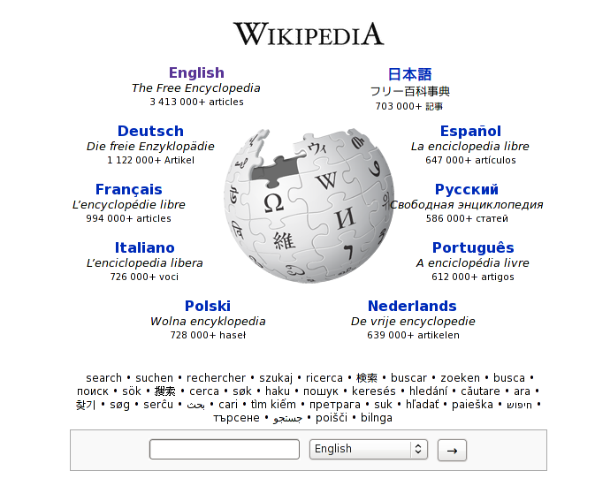
Wikipedia
Web

Slide 25
Torrent
Web Server
Tracker
Web page
with link
to .torrent
Get-announce
Response-peer list
pieces
C
A
pieces
Peer
[Seed]
Peer
[Leech]
Downloader
“US”
pieces
B
Peer
[Leech]

Slide 26
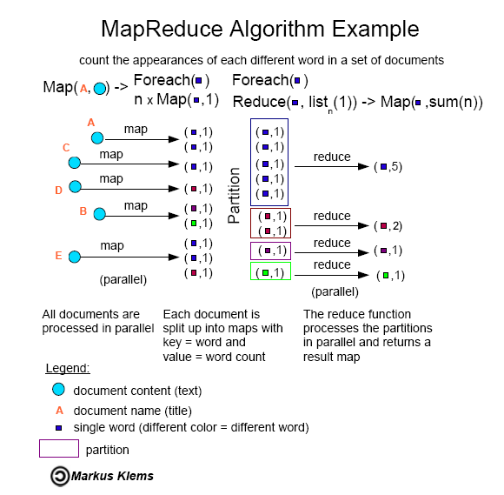
Hadoop (MapReduce)

Slide 27
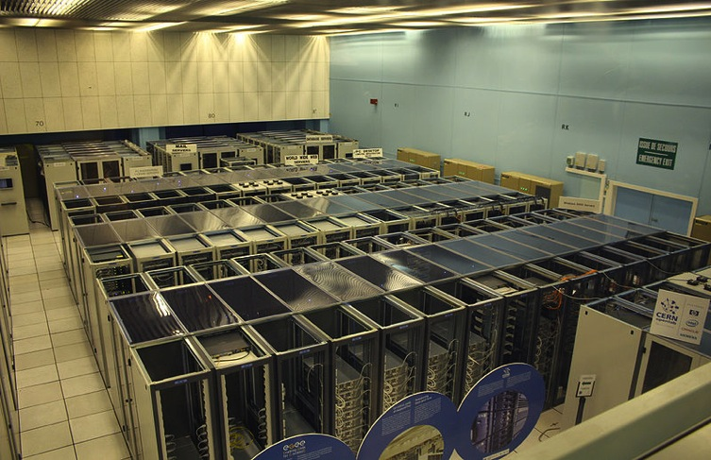
Condor
Distributed computing (clusters, farms)

Slide 28
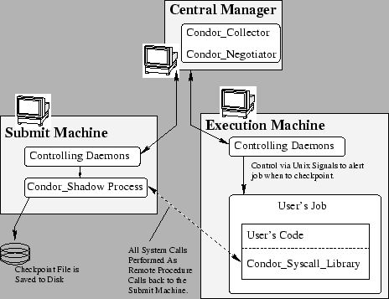
Condor
1992
Queuing policy
Match task and computing nodes
Resource Classification
Each resource can advertise its attributes and master can classify according to this
2010 (680k LOC)
Apache Web Server: ~60,000 LOC
Linux TCP/IP network stack: ~80,000 LOC
Windows XP (complete) : ~40 million LOC

Slide 29
grid

Slide 30
What is the Grid?
The World Wide Web provides seamless access to information that is stored in many millions of different geographical locations
The Grid is an infrastructure that provides seamless access to computing power and data storage capacity distributed over the globe
The LHC Computing Grid – Marian Babik (orig. by Rafal Otto, GridCafe), CERN

Slide 31
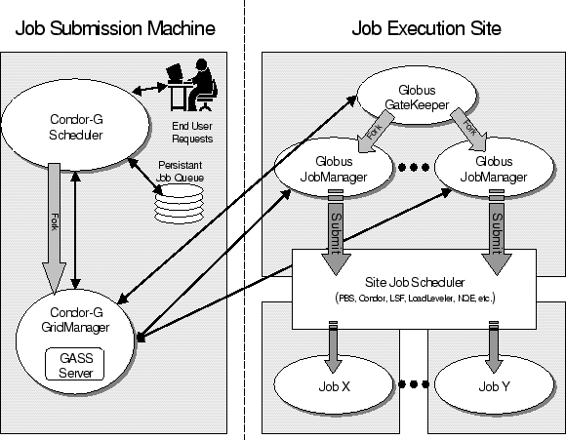
What is the Grid?
Distributed computing + Web ;-)
Request/response
Data resource (dataset)
Computational job

Slide 32
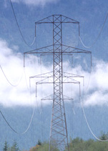
Grid history
Name “Grid” chosen by analogy with electric power grid (Foster and Kesselman 1997)
Vision: plug-in computer for processing power just like plugging in toaster for electricity.
Concept has been around for decades (distributed computing, metacomputing)
Key difference with the Grid is to realise the vision on a global scale.
The LHC Computing Grid – Marian Babik (orig. by Rafal Otto, GridCafe), CERN
Notes:
32

Slide 33
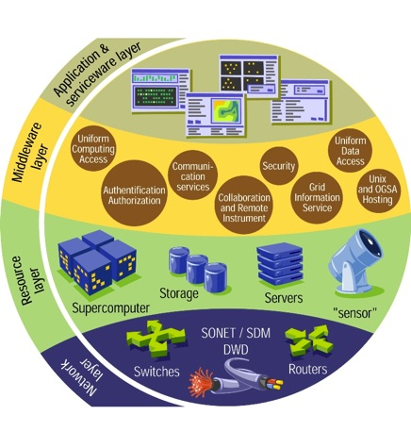
How does the Grid work?
It relies on advanced software, called middleware.
Middleware automatically finds the data the scientist needs, and the computing power to analyse it.
Middleware balances the load on different resources. It also handles security, accounting, monitoring and much more.
The LHC Computing Grid – Marian Babik (orig. by Rafal Otto, GridCafe), CERN
Notes:
33

Slide 34
Virtual Organization
The LHC Computing Grid – Marian Babik (orig. by Rafal Otto, GridCafe), CERN

Slide 35
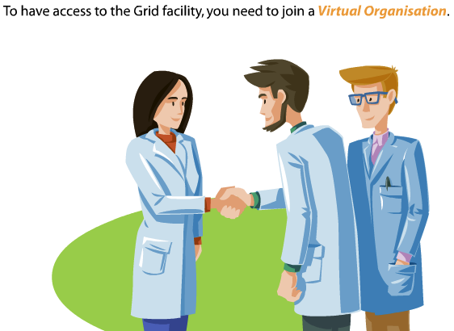
Step 1: Join Virtual Organization
The LHC Computing Grid – Marian Babik (orig. by Rafal Otto, GridCafe), CERN

Slide 36
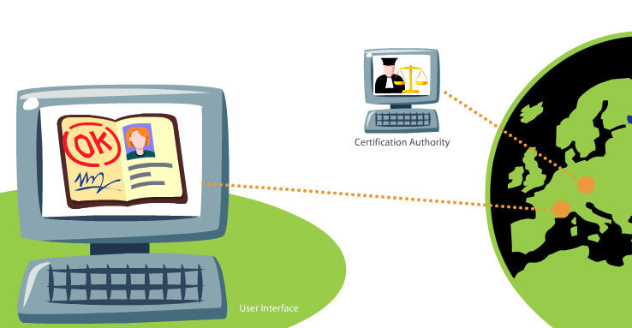
Step 3: Get a permission
The LHC Computing Grid – Marian Babik (orig. by Rafal Otto, GridCafe), CERN

Slide 37
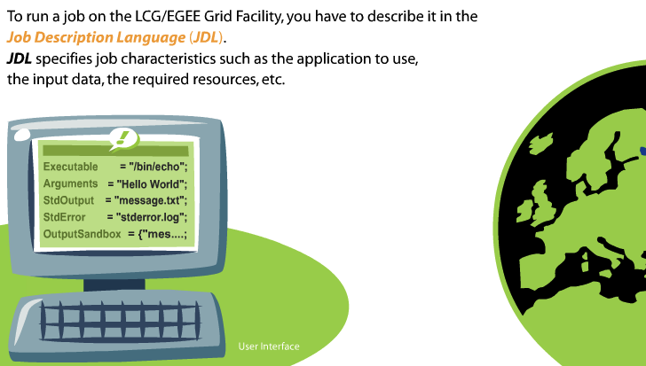
Step 4: Write a file describing your job
The LHC Computing Grid – Marian Babik (orig. by Rafal Otto, GridCafe), CERN

Slide 38
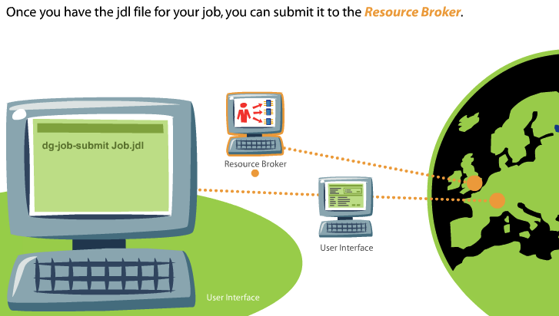
Step 5: Submit your job to the resource broker
The LHC Computing Grid – Marian Babik (orig. by Rafal Otto, GridCafe), CERN

Slide 39
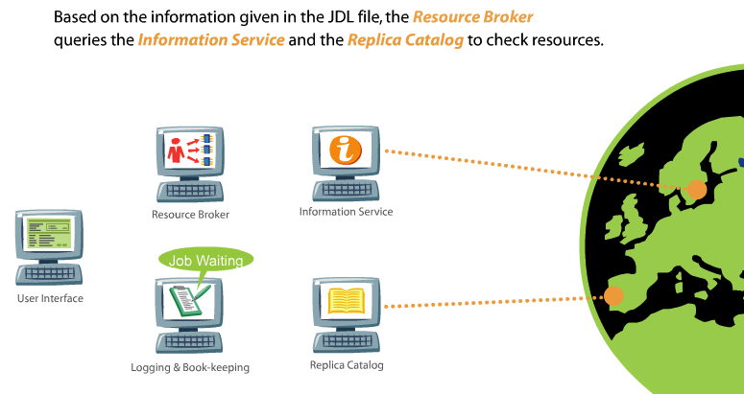
Step 5: Submit your job to the resource broker
The LHC Computing Grid – Marian Babik (orig. by Rafal Otto, GridCafe), CERN

Slide 40
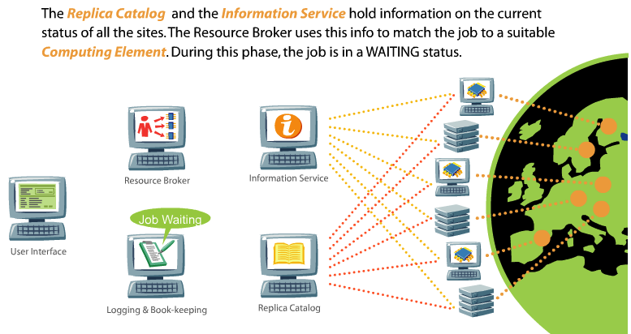
Step 5: Submit your job to the resource broker
The LHC Computing Grid – Marian Babik (orig. by Rafal Otto, GridCafe), CERN

Slide 41
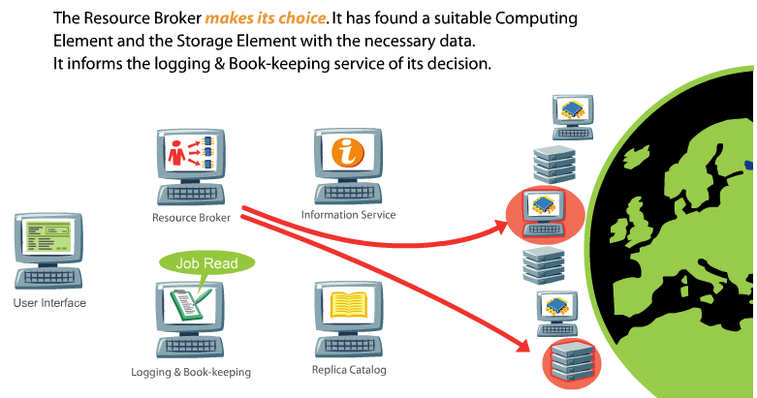
Step 5: Submit your job to the resource broker
The LHC Computing Grid – Marian Babik (orig. by Rafal Otto, GridCafe), CERN

Slide 42
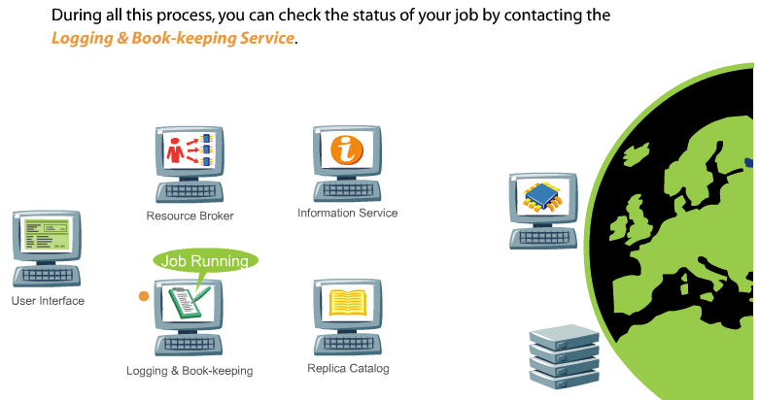
Step 6: Check the status of your job
The LHC Computing Grid – Marian Babik (orig. by Rafal Otto, GridCafe), CERN

Slide 43
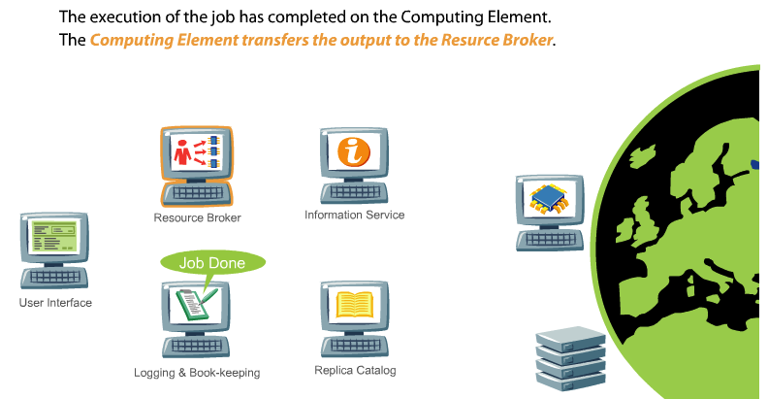
Step 6: Check the status of your job
The LHC Computing Grid – Marian Babik (orig. by Rafal Otto, GridCafe), CERN

Slide 44
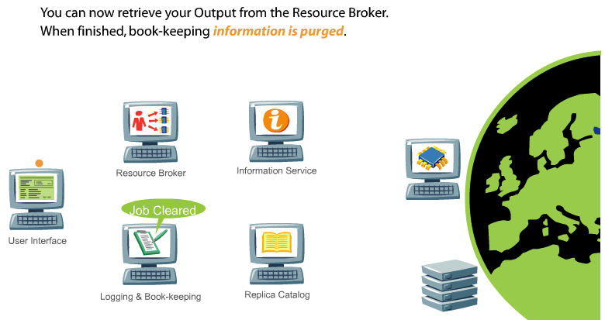
Step 7: Get the results
The LHC Computing Grid – Marian Babik (orig. by Rafal Otto, GridCafe), CERN

Slide 45
Why the Grid at CERN?
The LHC Computing Grid – Marian Babik (orig. by Rafal Otto, GridCafe), CERN
Notes:
45

Slide 46
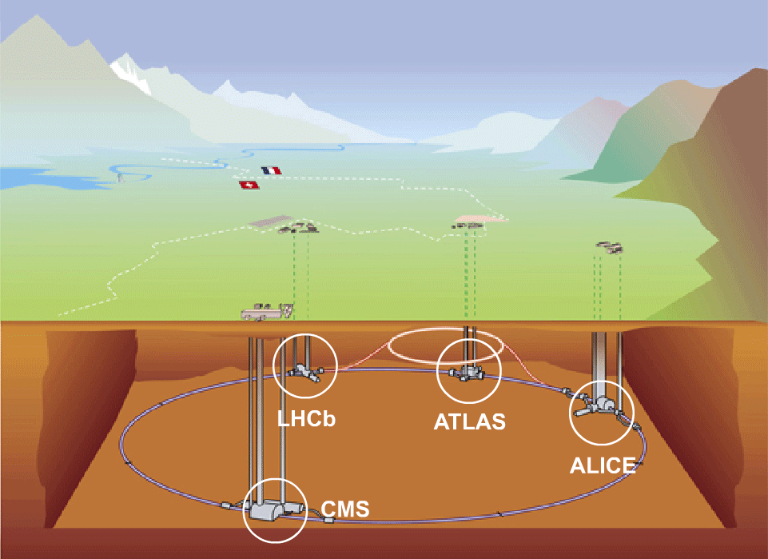
The LHC accelerator and the 4 experiments
The LHC Computing Grid – Marian Babik (orig. by Rafal Otto, GridCafe), CERN

Slide 47
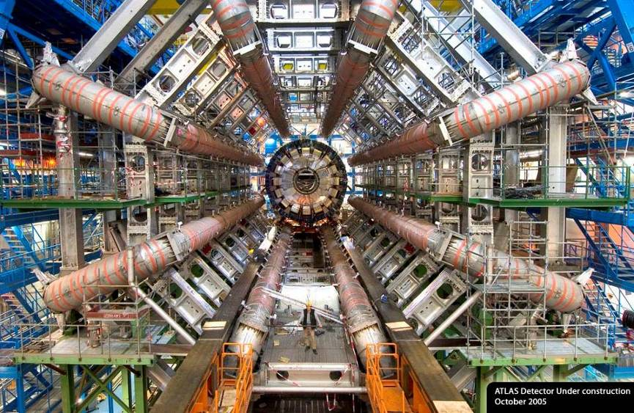
View of the ATLAS detector
150 million sensors deliver data … … 40 million times per second
The LHC Computing Grid – Marian Babik (orig. by Rafal Otto, GridCafe), CERN
Notes:
47

Slide 48
Frédéric Hemmer, CERN, IT Department

Slide 49
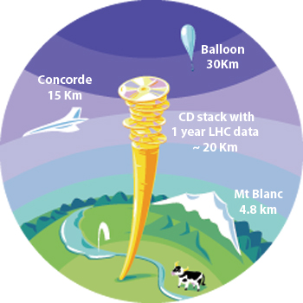
The LHC Data Challenge
The accelerator will run for 10-15 years
Experiments will produce about 15 Million Gigabytes of data each year (about 20 million CDs!)
LHC data analysis requires a computing power equivalent to ~100,000 of today's fastest PC processors
Requires many cooperating computer centres, as CERN can only provide ~20% of the capacity
The LHC Computing Grid – Marian Babik (orig. by Rafal Otto, GridCafe), CERN

Slide 50
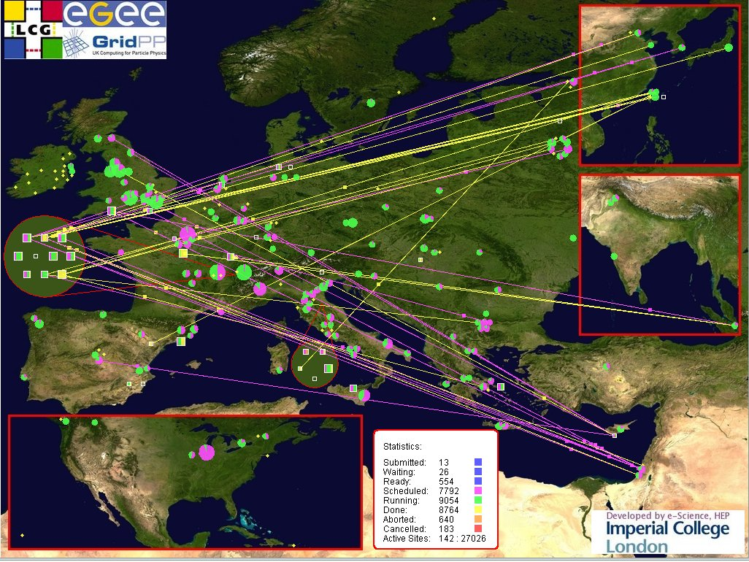
The LHC Computing Grid – Marian Babik (orig. by Rafal Otto, GridCafe), CERN
Notes:
170 computing centers in 36 countries, as of 2012

Slide 51
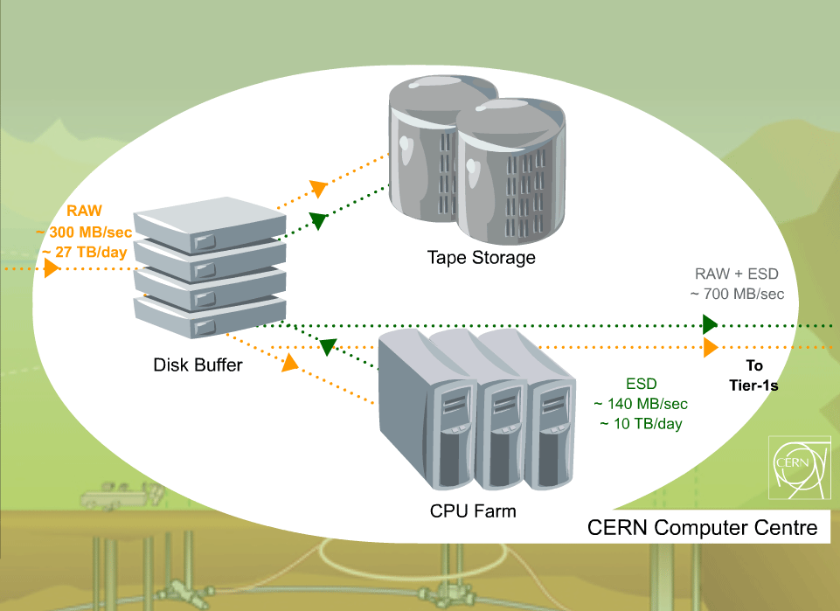
One Tier0 Centre (CERN)
From the Web to the Grid –2006

Slide 52
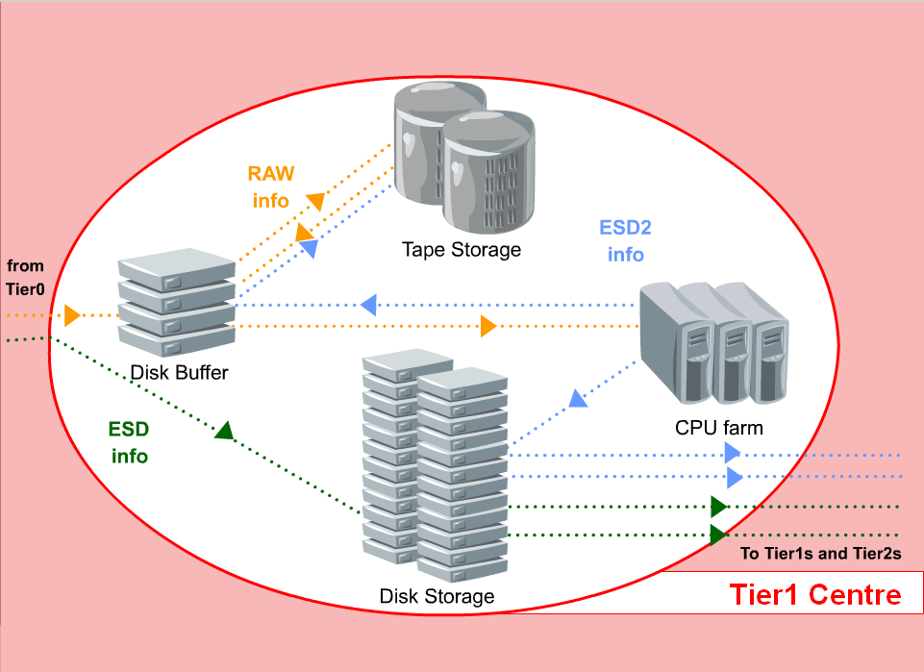
Eleven Tier1 Centres
From the Web to the Grid –2006

Slide 53
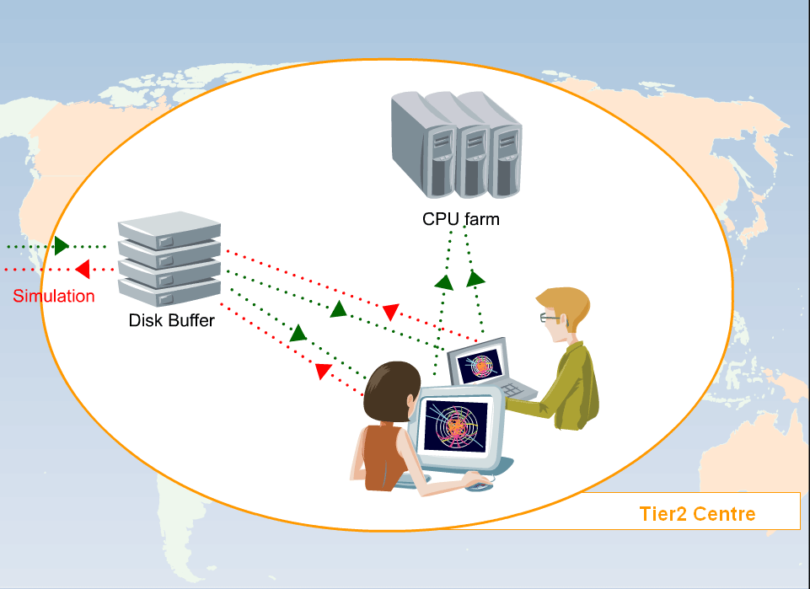
>100 Tier2 Centres
From the Web to the Grid –2006

Slide 54
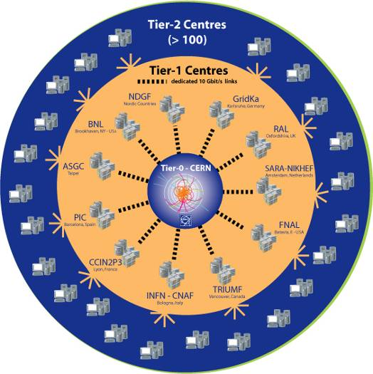
LHC Computing Grid project (LCG)
More than 170 computing centres
12 large centres for primary data management: CERN (Tier-0) and eleven Tier-1s
38 federations of smaller Tier-2 centres
35 countries involved
The LHC Computing Grid – Marian Babik (orig. by Rafal Otto, GridCafe), CERN

Slide 55
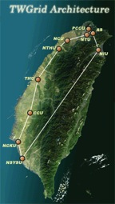
WLCG: Worldwide LHC Computing Grid
Project to build and maintain data storage and computing infrastructure for LHC
Uses infrastructure of several Grid organizations where 2 the biggest ones are
EGI (founded by EC)
OSG (founded by US)
The LHC Computing Grid – Marian Babik (orig. by Rafal Otto, GridCafe), CERN

Slide 56
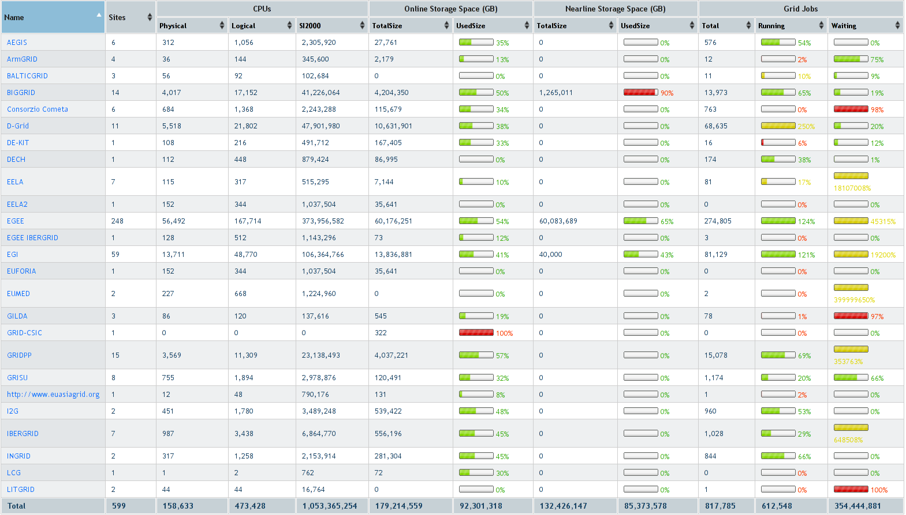
Resources needed for the LHC computing
The LHC Computing Grid – Marian Babik (orig. by Rafal Otto, GridCafe), CERN

Slide 57
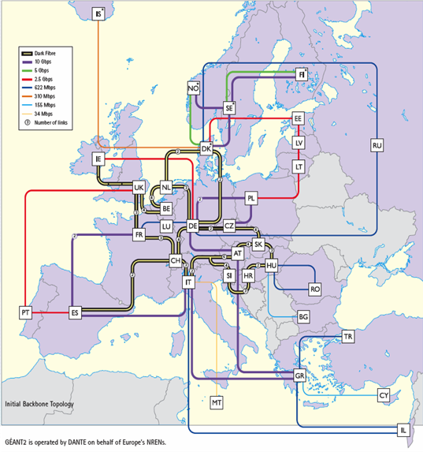
The Géant Research Network
General purpose network connecting national research and education nets (NREN)
For LHC in addition: Optical Private Network with 10Gb/s links over dark fibres
The LHC Computing Grid – Marian Babik (orig. by Rafal Otto, GridCafe), CERN

Slide 58
MetaCentrum – Czech Grid Initiative
Activity of CESNET association
http://www.metacentrum.cz/
Supporting ALICE, ATLAS, Auger, VOCE, EUAsiaVO, etc.
Tier 2 Sites:
PragueLCG2
Prague_CESNET_LCG2
Participating institutes:
CESNET
Masaryk University Brno
Charles University
West Bohemian University in Pilsen
Brno University of Technology
South Bohemian University in Ceske Budejovice
Notes:
Zapadoceska univerzita v Plzni

Slide 59
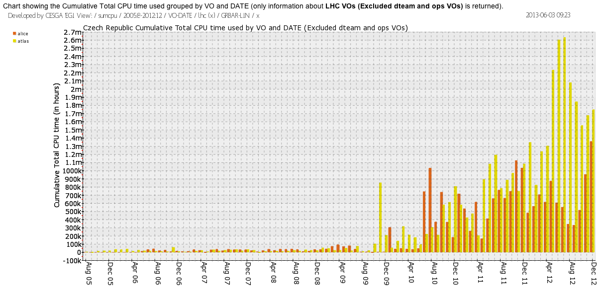
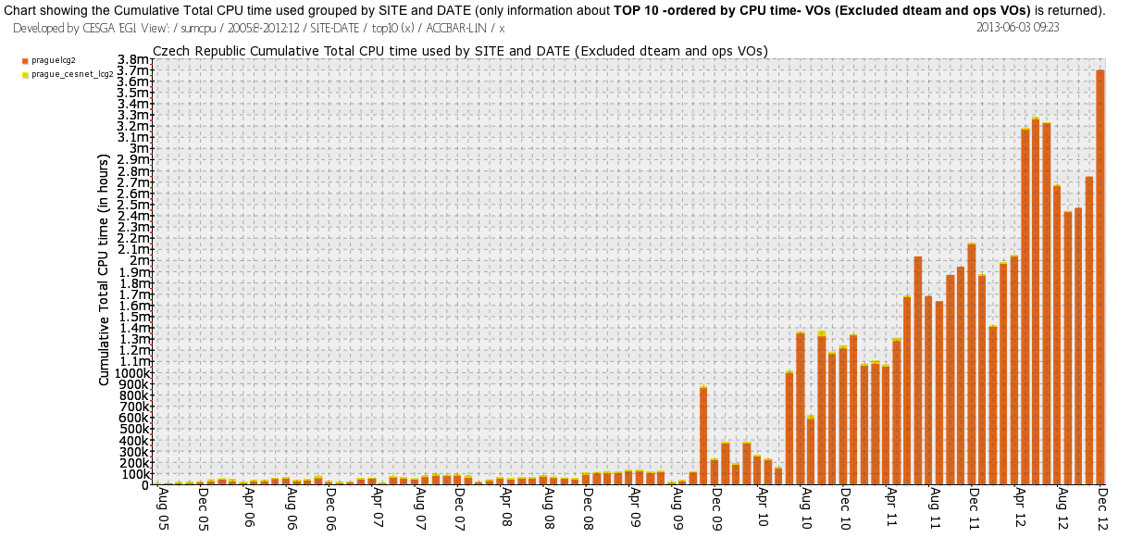
Czech Grid Initiative Activity
Czech Grid ran ~ 5.7M jobs in 2012 – workload has continued to increase

Slide 60
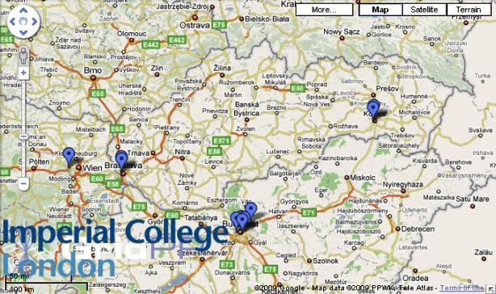
Slovak Grid Infrastructure
Slovakia is a federated Tier-2/3 HEP community
Slovak Grid Initiative / www.slovakgrid.sk
Tier 2 sites:
FMPHi-UNIBA – ATLAS, ALICE
IEPSAS-Kosice – ATLAS, ALICE, CDF, H1
TU-Kosice – VOCE, BIOMED
IISAS-Bratislava – ESR, VOCE, BIOMED
The LHC Computing Grid – Marian Babik (orig. by Rafal Otto, GridCafe), CERN
Notes:
60

Slide 61
Slovak Grid activity
Slovak Grid ran ~ 927k jobs in 2012 – workload has continued to increase
Distribution of work across Tier 2/Tier3 really illustrates the importance of the grid system

Slide 62
EGEE: Scientific disciplines
Growth and diversification of applications.
Reported apps. only ⇒ underestimate!
 | 6/2006 | 2/2007 | 1/2008
Astron. & Astrophysics | 2 | 8 | 9
Computational Chemistry | 6 | 27 | 21
Earth Science | 16 | 16 | 18
Fusion | 2 | 3 | 4
High-Energy Physics | 9 | 11 | 7
Life Sciences | 23 | 39 | 37
Others | 4 | 14 | 21
Total | 62 | 118 | 117
Condensed Matter Physics
Comp. Fluid Dynamics
Computer Science/Tools
Civil Protection
Finance
The LHC Computing Grid – Marian Babik (orig. by Rafal Otto, GridCafe), CERN

Slide 63
SPM: Alzheimer’s disease evaluation
Statistical Parametric Mapping (SPM) – powerful but difficult to use
Need of huge amount of data –> sharing instead of building own repositories
Computational power needed to achieve results fast enough
The LHC Computing Grid – Marian Babik (orig. by Rafal Otto, GridCafe), CERN

Slide 64
WISDOM: In silico drug discovery
April 2006, Asian and European labs analysed 300K possible drug components against the H5N1 virus using EGEE infrastructure
2000 computers for 4 weeks
(equivalent of 100 years on a single computer)
Preparation for the second run are ongoing
October 2006 – January 2007, the same analysis for malaria resulted in 140 million dockings (80 000 per hour)
5000 computers for 2.5 month (equivalent of 420 years on a single computer)
The LHC Computing Grid – Marian Babik (orig. by Rafal Otto, GridCafe), CERN

Slide 65
GATE: radiotherapy planning
Goal is to improve accuracy of the treatment of cancer by ionizing radiations of the tumours
Therapy planning is computed from the MR (Magnetic Resonance) scans
Tumours are accurately located in 3D
Radiation doses needed to be applied are computed
Due to the Monte Carlo approach – very easy to divide in the parallel
The LHC Computing Grid – Marian Babik (orig. by Rafal Otto, GridCafe), CERN

Slide 66
SEE++: Virtual Eye Surgery
Simulation system that aims at the forecast of clinical operation results
Used to simulate pathologies and evaluate possible treatments
User presentation on the client -> computation in the Grid
The LHC Computing Grid – Marian Babik (orig. by Rafal Otto, GridCafe), CERN

Slide 67
GEOSCOPE: determine the earthquake source
Localization of earthquakes
Determination of rupture modes of the faults
Results within a few hours of major earthquakes
date = 6 Jan. 2008
time = 5:14:17
depth = 50.9 km
magnitude = 6.1
latitude = 37.150°
longitude = 22.934°
The LHC Computing Grid – Marian Babik (orig. by Rafal Otto, GridCafe), CERN

Slide 68
The Grid = SETI@HOME ???
The GRID
Reliable computer centres
Hardware and software
Dedicated,
Static,
Fully controlled
costs
SETI@HOME
Home PCs
Hardware and software
Heterogeneous
Shared
Dynamic
“for free”
Massively
parallel
Massively
distributed
The LHC Computing Grid – Marian Babik (orig. by Rafal Otto, GridCafe), CERN

Slide 69
Cloud

Slide 70
Cloud
Web-based computing, whereby shared resources, software and/or information are provided to computers and other devices on-demand.
Providers
Amazon EC2 Cloud
Google Compute Engine
Azure
Service models
Computer (PaaS)
Web/Database (SaaS)
Cluster (IaaS)
Network (NaaS)

Slide 71
References
Wikipedia (www.wikipedia.org)
Web
Semantic Web
Linked Data (linkeddata.org)
Wolfram alpha (www.wolframalpha.com)
Grid
EGEE (www.eu-egee.org)/ EGI
SlovakGrid (www.slovakgrid.sk)
WLCG(lcg.web.cern.ch)
Cloud
Amazon EC2 service, Google Web Apps

Slide 72
Summary
World Wide Web – born at CERN - elaborate set of interlinked documents accessible over the Internet
Grid computing
Infrastructure that provides seamless access to computing power and data storage
Suitable for problems that need huge/shared data, can run in parallel or need to be run frequently
EGI – largest existing European Grid infrastructure (academic)
Slovak Grid Initiative
Many existing applications besides high energy physics
The LHC Computing Grid Marian Babik (orig. by Marian Babik (orig. by Rafal Otto, GridCafe), GridCafe),, CERN

Slide 73
Commercial Software
Gaussian
http://www.gaussian.com/
Predicts the energies, vibrational freq., … of molecular systems.
VO-based licensing model, actually in use in gaussian VO.
MathWorks
http://www.mathworks.com/
Integrate MATLAB & Distributed Computing Engine with EGEE.
Both client and server are licensed in this model.
Interactive Supercomputing
http://www.interactivesupercomputing.com/
Similar to DCE; used from multiple clients (MATLAB, Python, R)
Server licensed, some clients licensed
The LHC Computing Grid – Marian Babik (orig. by Rafal Otto, GridCafe), CERN

Slide 74
The LHC Computing Grid – Marian Babik (orig. by Rafal Otto, GridCafe), CERN
Notes:
74

Slide 75
Why was the Web invented at CERN?
Science depends on free access to information and exchange of ideas. CERN is the hub of a worldwide community of 6500 scientists in 80 countries.
CERN has a long history of being at the forefront of scientific computing and networking (first lab on Internet outside the US).
During the preparation of the previous large project LEP, the need to share documents in a global way became vital.
The LHC Computing Grid – Marian Babik (orig. by Rafal Otto, GridCafe), CERN
Notes:
75

Slide 76
How did it start?
1989: Tim Berners-Lee circulates “Information Management: A proposal” to help with future Large Hadron Collider project.
1991: Early www system released to high energy physics via the CERN program library. First web servers located in European physics laboratories.
1993: First Mosaic browser; web reaches 500 servers and 1% of Internet traffic; CERN places WWW in the public domain.
The LHC Computing Grid – Marian Babik (orig. by Rafal Otto, GridCafe), CERN
Notes:
76
Note: Mention the famous remark of TBL’s boss “Interesting but vague” about the proposal! TBLs paper specifically refers to LHC in first line “Many of the discussions of the future at CERN and the LHC era end with the question “Yes, but how will we ever keep track of such a large project” . Putting it in the public domain (under open source licence due to F Fluckiger) ensures it is widely adopted.

